Slide 1
Transportation Equity Needs and Barriers Assessment RFP

Slide 2
Agenda and Housekeeping
Agenda
Housekeeping
Intros and MassCEC Overview
Assessment Background and Goals
Scope of Work (4)
Budget & Eligibility
Application Resources
How to Apply
Application Timeline
FAQs
Questions
Please post all questions in the Q&A Box at the bottom of your screen
The webinar recording will be posted online along with the slides and a document detailing the webinar Q&A
We will not be sharing the list of attendees

Slide 3
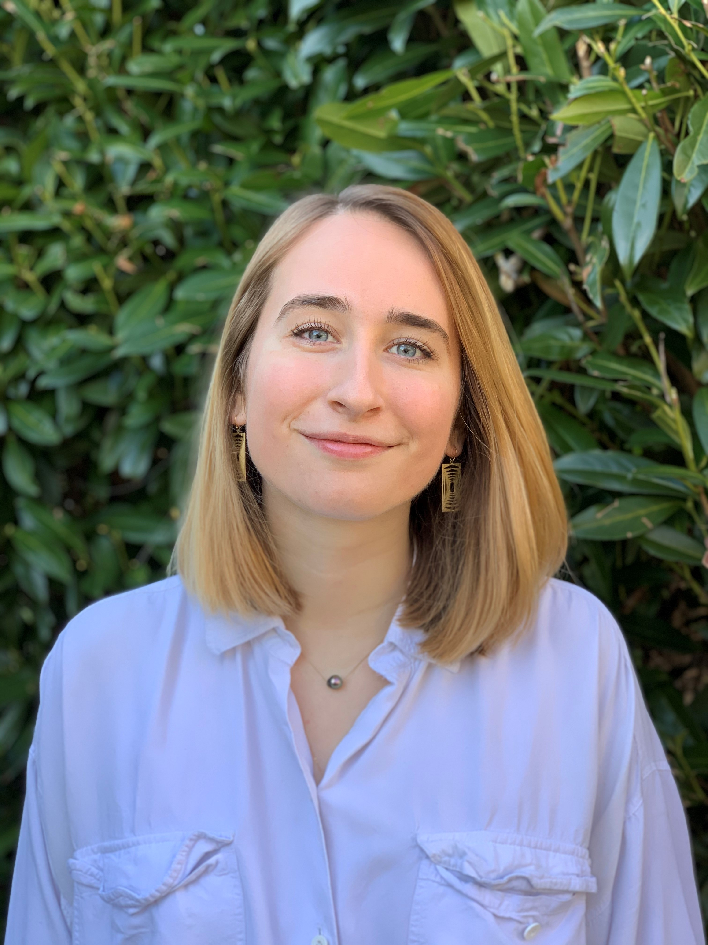
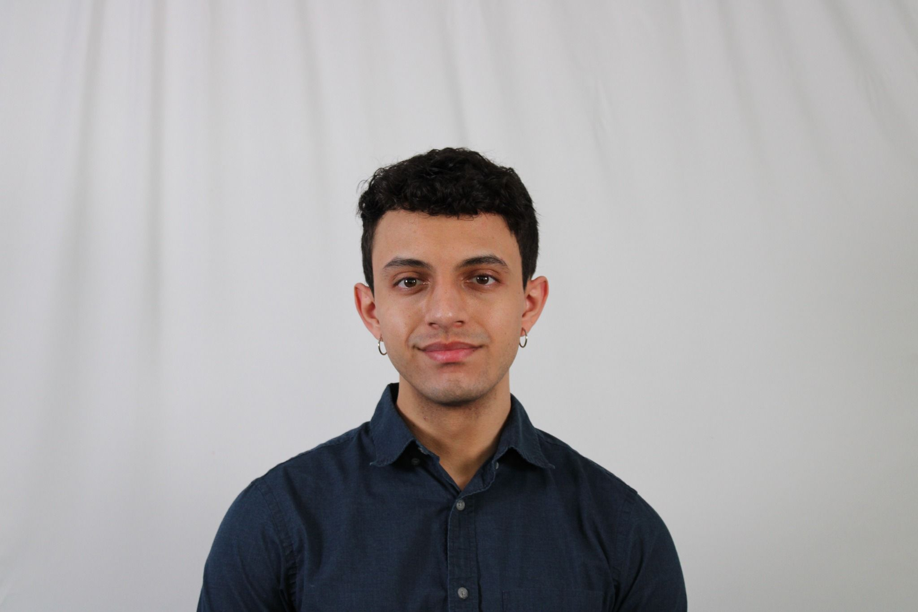
Intro to Speakers
Rhys Webb
Program Director
Karl Adrianza
Program Administrator

Slide 4
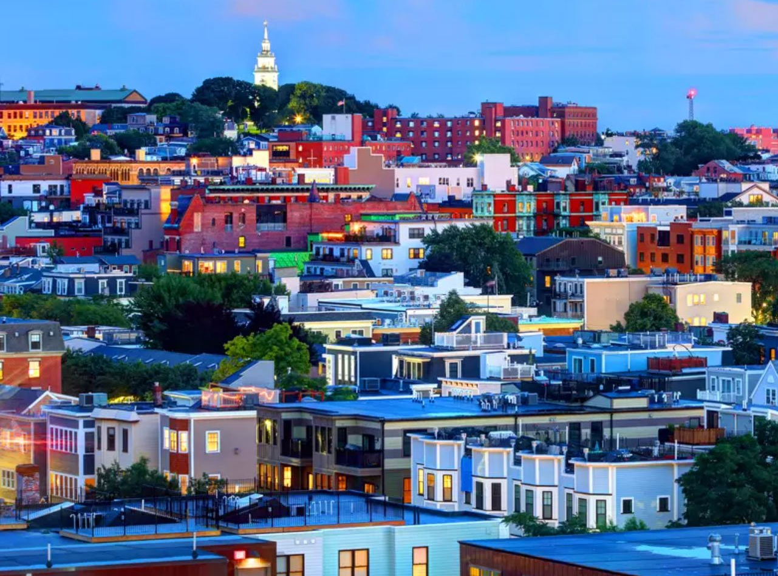
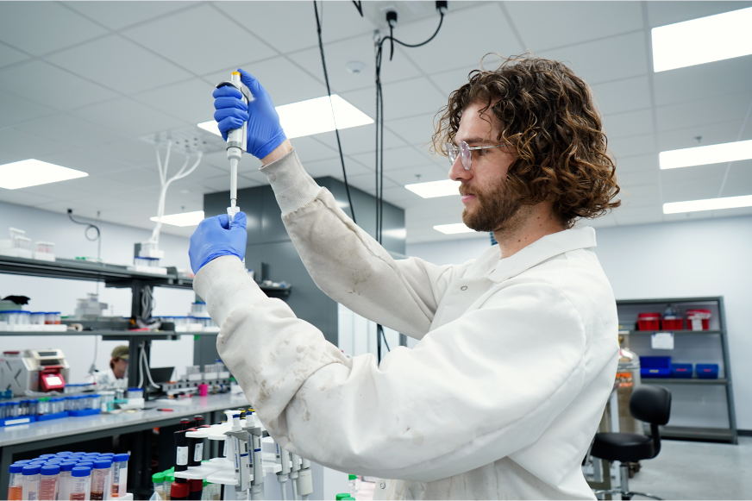


ACCELERATING
DECARBONIZATION
EMERGING CLIMATETECH
We contribute to meeting our state's ambitious climate goals by tackling barriers to widespread use of clean energy and climate technology in buildings, transportation,
and the grid.
We help new climate- focused businesses grow faster by backing a vibrant community of researchers, startups, and established industry players - creating an ecosystem where they connect and thrive.
MASSCEC’S WORK BY FOCUS AREA
LARGE SCALE DEPLOYMENT: OFFSHORE ENERGY
CLEAN ENERGY & CLIMATE WORKFORCE DEVELOPMENT
We're building a cutting- edge offshore energy industry, marshaling world-class ports while addressing supply
chain and workforce
development challenges.
We’re growing a diverse and
talented clean energy workforce by supporting a dynamic network of community-based organizations,
labor, training providers, schools and employers committed to a
sustainable future for all.
4

Slide 5
Equity & Clean Transportation Background
background
Accelerating clean transportation for all (ACT4AlL)
The transportation sector in MA is responsible for 37% of statewide greenhouse gas emissions
As the Clean Energy and Climate Plan (“CECP”) highlights, “communities of color, low-income neighborhoods, Indigenous populations, and neighborhoods with high percentages of residents with limited English proficiency face disproportionately higher exposure to pollution, public health, and climate risks, and bear a higher energy burden when compared with other neighborhoods.”
Program goals:
Increase access to clean transportation
Decrease burdens from the existing transportation systems
Projects are:
Replicable/scalable
Innovative
Equitable
Previously funded $16M to 21 projects between 2022-2024. Topics included:
E-bike incentives and e-bike share models
Vehicles-for-hire and carsharing electrification
EV charging accessibility

Slide 6
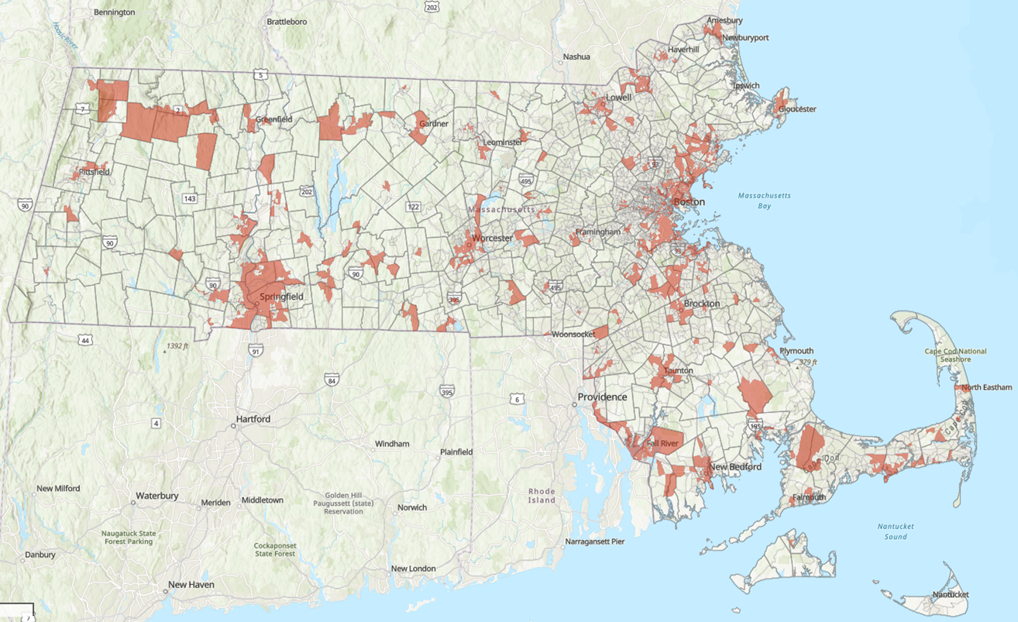
Burdened Areas (formerly Environmental Justice Communities)
methodology
Uses 30 statewide indicators to characterize Pollution and Climate Burden and Population Characteristics
Pollution and Climate Burden
Environmental Exposures
Environmental Effects
Climate Risks
Population Characteristics
Sensitive Populations
Socioeconomic Factors
Burdened Area scores (risk) = Pollution and Climate Burden (threat) x Population Characteristics (vulnerability)

Slide 7
Transportation Equity Needs and Barriers Assessment
goals
structure
Provide residents of Burdened Areas and organizations that serve them with the opportunity to provide meaningful input on state-level programming
Identify key needs/barriers that future clean transportation programming can address
Understand how these needs/barriers differ across MA regions and demographics
Stakeholder engagement period to include focusgroups, surveys, interviews, etc.
Recruitment process development for and onboarding of CBO partners
CBO partners will be identified through a separate RFI process
Development of data collection approach and educational resources for outreach
Synthesis of findings and presentation of results
parameters
No strict limitations on types of (clean) transportation – could include micromobility, light-/medium-/heavy-duty transportation, public transit, etc.
Findings should only consist of needs for/barriers to clean transportation that Burdened Areas face, not programmatic recommendations – MassCEC will be responsible for subsequently developing programming
Pages
3-4
of the RFP

Slide 8
Opportunities for Involvement
Lead Consultant
CBO Partner
Should apply to this RFP
Responsibilities include:
Develop outreach materials (surveys, educational content, etc.)
Facilitate interviews/focus groups/events
Ongoing CBO Partner support with resources, compensation distribution
Support with participant education on transportation topics
Data collection and synthesis to develop final identification of needs and barriers
Should indicate interest in participating in engagement efforts in May 2026 – MassCEC RFI
Responsibilities include:
Distribute educational and engagement materials
Conduct outreach and recruit participants for engagement opportunities
Host focus groups
Participate in focus groups and provide feedback directly
OR

Slide 9
Scope of Work

Slide 10
Scope 1: Management and Reporting
Scope Summary
Consultant will be responsible for monthly reporting and a reflection memo upon completion of the Assessment.
Ongoing Management
The Consultant will be responsible for oversight of the Assessment and any communication between MassCEC, the Consultant Team, CBOs, and relevant project stakeholders. The Consultant will be available for a Kickoff Call and subsequent monthly Assessment Status Calls with MassCEC, and will produce a corresponding monthly Status Slide Deck.
Assessment Process Reflection
Upon completion of the Assessment, the Consultant will produce an Assessment Process Reflection that will remain internal to MassCEC and state partners. The Process Reflection is intended to provide an overview of Assessment process successes, challenges, and lessons learned. The Process Reflection should include a summary of and reflection on best practices for administrative topics (e.g. outreach, compensation, translation, etc.)
Page
6
of the RFP

Slide 11
Scope 2: Assessment Design
Scope Summary
Consultant will be responsible for familiarizing themselves with MassCEC Clean Transportation programming, proposing a process for bringing on select CBOs as partners for outreach under the Assessment, and executing this process.
MassCEC Assessment Onboarding
The Consultant will work with MassCEC to develop an understanding of the content and goals of assorted MassCEC Clean Transportation programs, with a focus on ACT4All and other equity-based initiatives, through onboarding materials (previous RFPs, program applications, program reports, etc.) and Onboarding Calls. The Consultant will submit a high-level of Theory of Change on the Assessment and how it can impact future programming
CBO Partner Identification and Recruitment Process
MassCEC will issue a separate Request for Information (RFI) in May 2026 to solicit responses from CBOs interested in partnering on the Assessment
Using the list of CBO RFI responses provided by MassCEC, and any other orgs identified by either the Consultant or MassCEC, the Consultant will propose a CBO Partner Recruitment Process proposing how to engage CBOs and the various pathways for involvement they can be offered.
CBO Partner Recruitment
Following the Recruitment Process described above, the Consultant will engage identified CBOs to confirm participation/level of involvement, support to be offered to CBO, and proposed CBO responsibilities. The Consultant will submit a Summary of Recruitment Process outlining the results of this engagement, including specifics on how each CBO will be involved in supporting the Assessment
Pages
7-9
of the RFP

Slide 12
Scope 3: Outreach and Engagement
Scope Summary
Consultant will develop materials for and infrastructure for tracking outreach, support CBO partners in conducting stakeholder engagement, and synthesize findings/data collected through engagement.
Data Collection Approach
Consultant will develop a Data Collection Approach to be used throughout engagement efforts, including but not limited to:
Surveys
Interview Questions
Focus Group Questions
Educational Resources
Consultant will develop Educational Resources on clean transportation topics to be used throughout engagement. Format should be informed by initial conversations with CBO partners, and materials should be designed with varying levels of technical information to reach audiences with varying levels of subject matter knowledge
Burdened Areas Engagement
Following the specifics determined with CBO partners in Scope 2, the Consultant will support CBOs in conducting outreach and engaging residents of Burdened Areas as appropriate. Interpretation and translation should be included as needed.
Data Synthesis
Consultant will be responsible for centralizing data and findings from each CBO’s outreach work and minimizing administrative burden on CBOs
Findings should be stored in a Consolidated Database accessible to MassCEC and organized by themes/topics
Pages
9-10
of the RFP

Slide 13
Scope 4: Development of Draft and Final Recommendations
Scope Summary
Consultant will develop draft findings based on information collected through outreach, collect feedback on draft findings, and incorporate this feedback by developing a final presentation/summary.
Draft Findings Presentation
Consultant will develop a Draft Findings Presentation summarizing feedback collected through engagement on clean transportation needs/barriers
Consultant will collect feedback from CBOs and other state agencies; CBOs should add nuance and weigh in on accuracy of findings/provide feedback on how to prioritize
MassCEC will oversee coordination with state agencies. Applicants should not reach out to state agencies for the purposes of this RFP.
Final Recommendations
Using feedback on the Draft Findings, Consultant will develop a Final Findings Presentation and accompanying Executive Summary identifying roughly five (5) needs and/or barriers that could be address through state clean transportation programming
Final Findings Presentation should also cover an overview of the Assessment process, approach to data collection, and general demographics of respondents, as well as common needs/barriers identified separate by transportation subsector
Once approved, Consultant present the Final Findings Presentation to CBO partners and state agencies
Pages
11-12
of the RFP

Slide 14
Application Details

Slide 15
Budget
MassCEC has $300k total allocated to fund this Assessment, covering Assessment costs (including compensation to CBO partners) and Consultant costs
Applicants should propose clearly elaborated and justified budgets associated with the primary Scopes of Work and corresponding Tasks.
Applicants should reserve appropriate compensation for CBO partners in proposed budgets
Applicants should include a detailed breakdown of all relevant assumptions that informed budget development, such as:
Estimated number of and compensation rates for CBO partners
Estimated number of focus groups conducted and associated support services (e.g. childcare, transportation, etc.)
Estimated interpretation/translation expenses
Consultant will be paid on a milestone basis based on a deliverables schedule.
Pages
16-17
of the RFP

Slide 16
Eligibility
MassCEC is open to Applicant Teams that include multiple firms. Applicant teams will work together on a proposed project with one entity designated as the Lead Applicant
Applicants/Teams should not apply with CBO partners – MassCEC will conduct a separate RFI process
The successful Applicant to this RFP will demonstrate the following experience (with particular emphasis on the first 3 bullets):
Experience working directly with MA Burdened Areas and/or collaborating with entities that serve Burdened Areas in MA;
An understanding of the resource and capacity needs and constraints of these populations and entities.
Experience with professional interview and focus group facilitation;
Experience with transportation and clean transportation subject matter;
Experience with program/project management;
Experience with data collection, synthesis, and analysis; and
Experience synthesizing complex technical concepts.
Pages
4-5
of the RFP

Slide 17
Application Resources
MassCEC will accept questions on a rolling basis until Wednesday April 29th, 2026.
Answers will be posted to website by May 6th, 2026
Submit all questions to CleanTransportation@MassCEC.com with “Transportation Equity Assessment RFP Questions” in the subject line
Please visit the MassCEC Transportation Equity Assessment RFP Webpage for more information regarding the Assessment
Join our mailing list to be notified of other opportunities
A recording of the webinar will be posted to the webpage following the event
Join the Slack channel to network/meet other prospective Applicants and form Applicant teams
Page
17
of the RFP

Slide 18
How to Apply
Application Details
Submit a completed proposal, not including recommendation letters. The submission must be in electronic form (one PDF file), including all relevant attachments, submitted via email to CleanTransportation@MassCEC.com. “Transportation Equity Needs and Barriers Assessment RFP” must appear in the e-mail subject line.
Submission packages
Applicant’s Signature and Acceptance Form
Executive Summary
Proposal, including:
Statement of Qualifications
Burdened Populations Engagement Approaches
Workplan Narrative
Project Schedule
Budget and Rate Sheet
References
Team Member Resumes (as an appendix)
Pages
12-14
of the RFP

Slide 19
Application Timeline
May 22, 2026
Transportation Equity Needa and Barriers Assessment RFP Applications due
May 6, 2026
April 16, 2026
Questions due to MassCEC via email to CleanTransportation@MassCEC.com by 4:59 PM ET.
April 13, 2026
Release of RFP
June 2026
Webinar
Opportunity to review RFP material, submit questions, etc.
Questions with Answers Posted to the RFP Webpage
April 29, 2026
Interviews (if necessary) and award decision
Submit by 4:59 PM ET. to CleanTransportation@MassCEC.com
Page
5
of the RFP

Slide 20
FAQs
Can I apply if my Applicant Team is not all MA-based?
Yes, but experience working with Burdened Areas in MA specifically is strongly encouraged.
What is the term length of the Assessment?
Contracting will be completed around August 2026
Work is expected to begin September 2026
No fixed term length; the Assessment will continue until completed, per the contract
MassCEC expects the Assessment to last about one (1) year
What is the geographic radius of this Assessment?
The Assessment should collect statewide feedback in Burdened Areas. MassCEC would like to receive feedback from all six (6) MA regions as defined by the MA Executive Office of Health and Human Services
How many CBOs should the Consultant expect to work with?
The Consultant should plan to compensate at minimum six (6) CBOs to ensure representation from all six (6) MA Regions. MassCEC expects that the Consultant will connect with, share information through, and potentially compensate at lower funding amounts, ten (10) to twenty (20) additional CBOs.

Slide 21

Thanks for Joining Us! CleanTransportation@MassCEC.com

