Slide 1
Maritime And Aviation Decarbonization Sector Mapping RFP

Slide 2
Agenda Overview
Intros and MassCEC Overview
Program Background and Goals
Scope of Work (4)
Budget & Eligibility
Application Resources
How to Apply
Application Timeline
FAQs
Questions

Slide 3
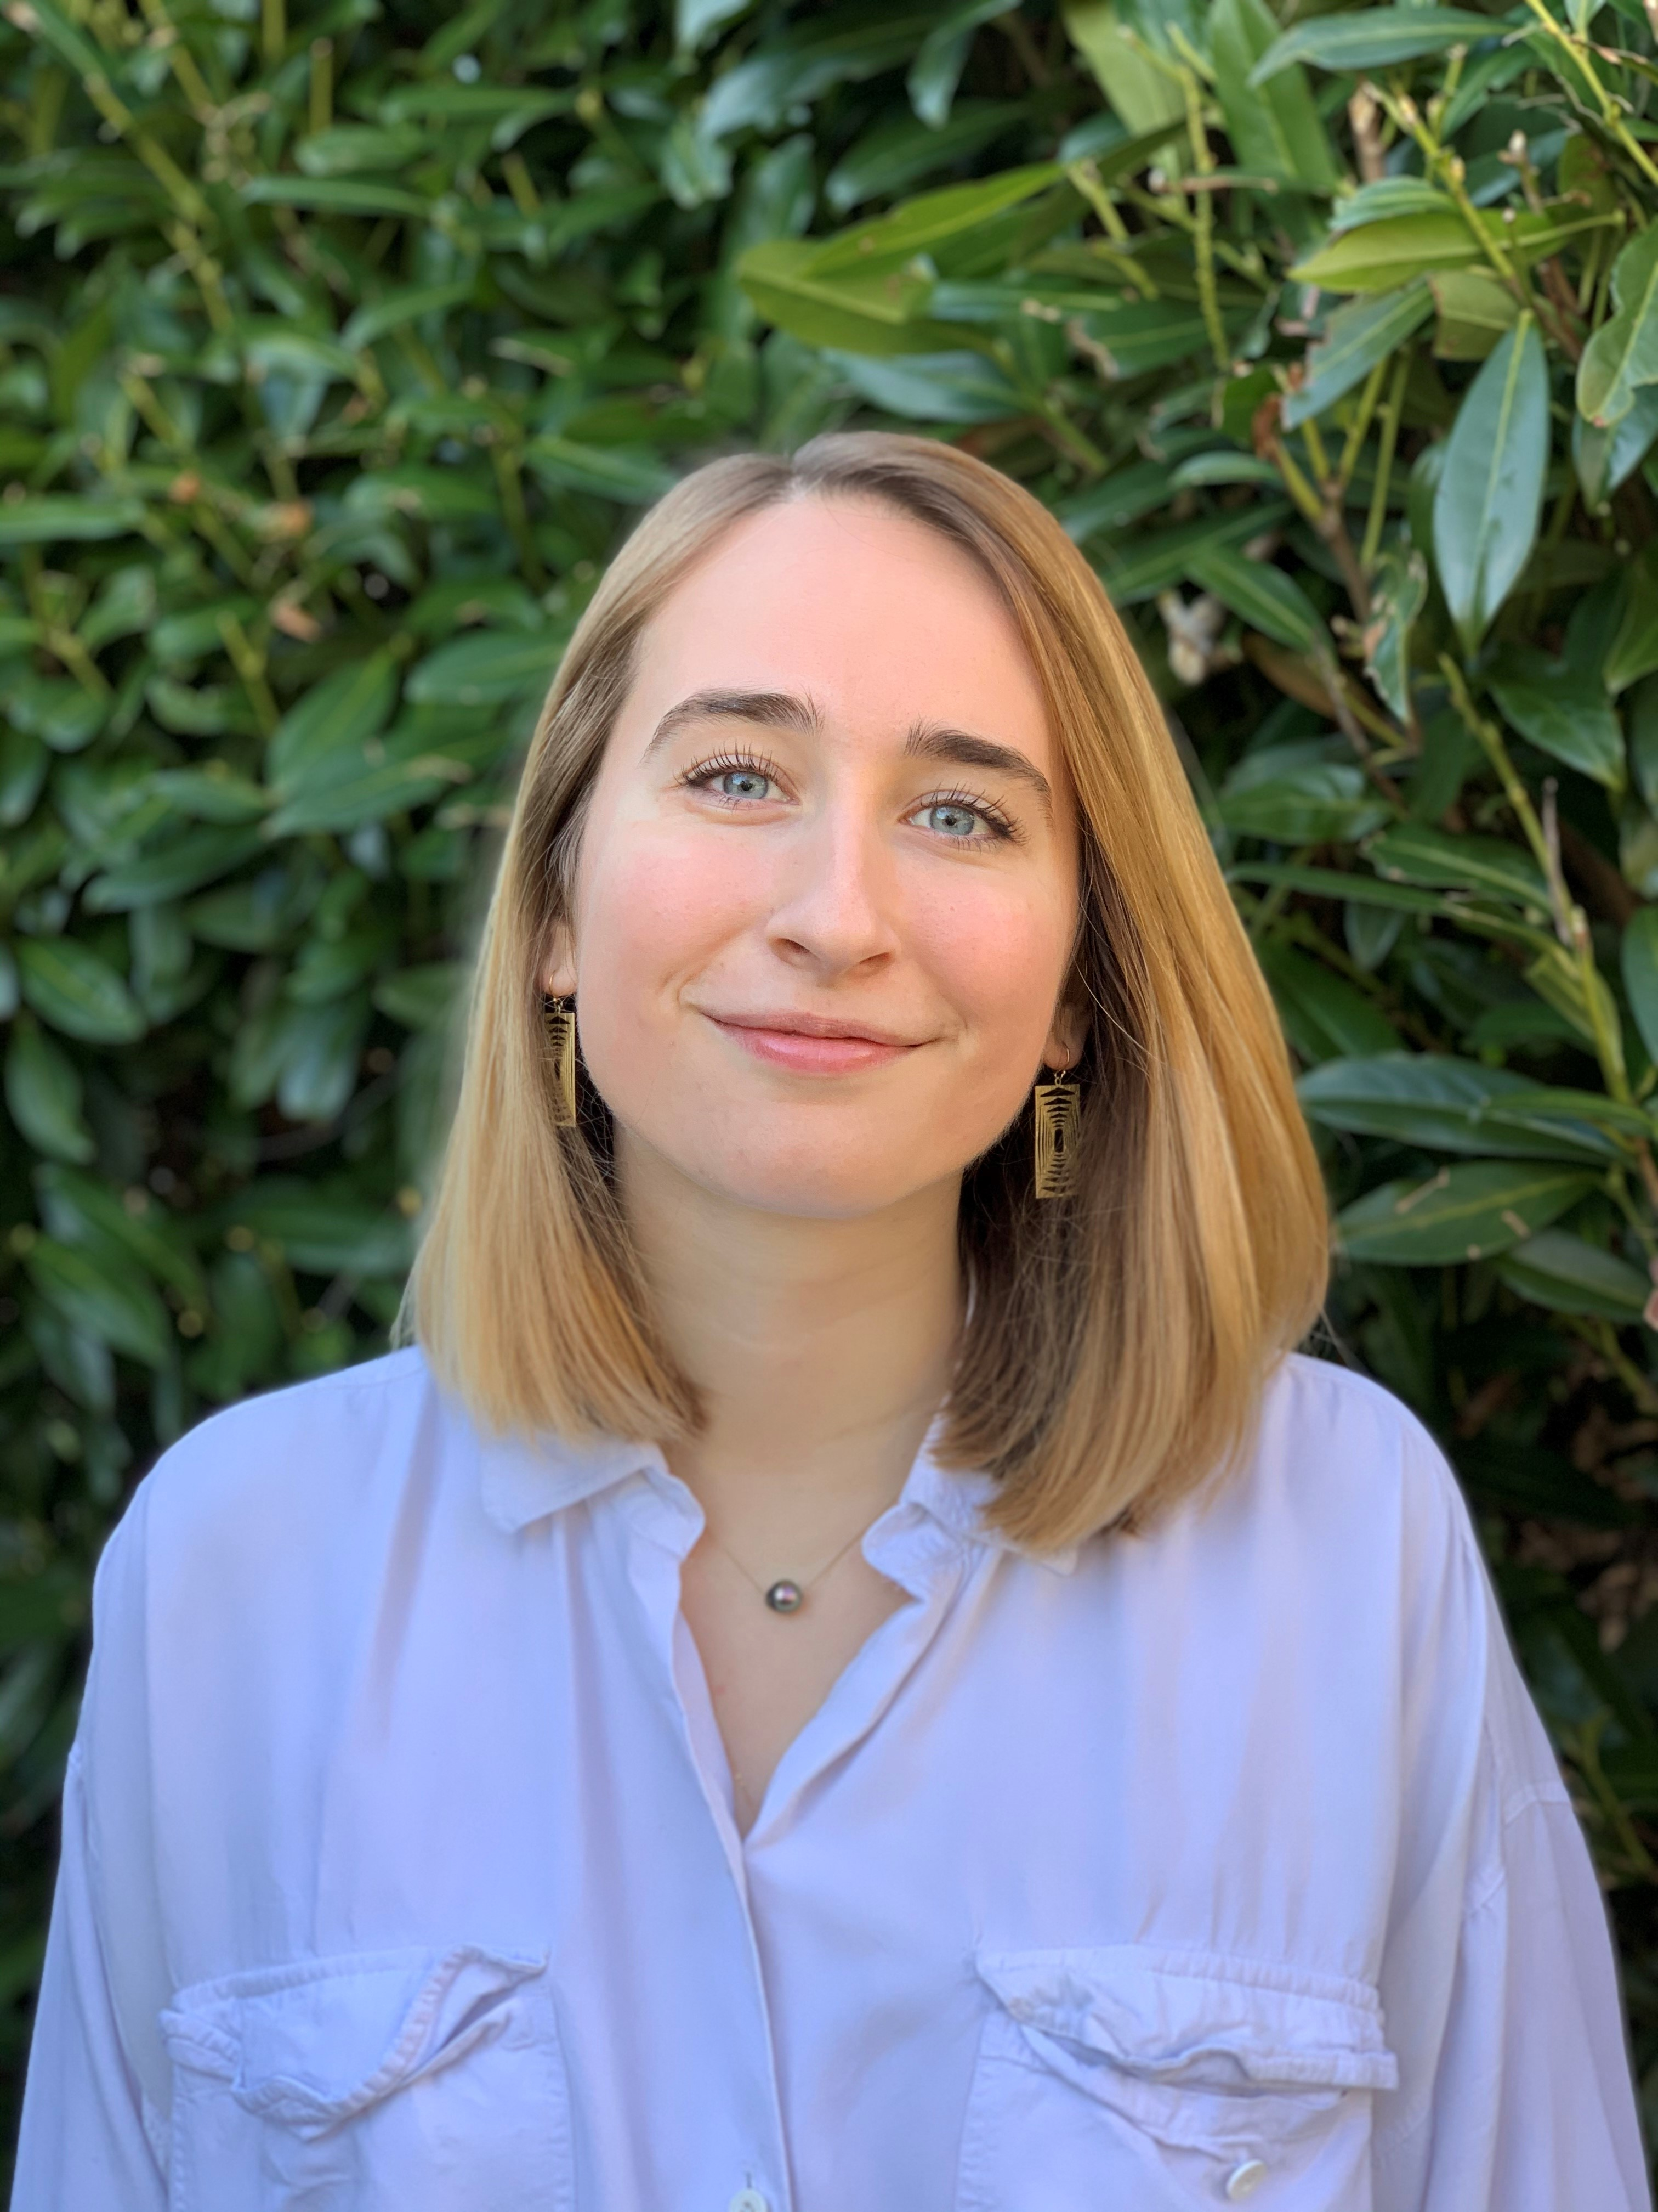
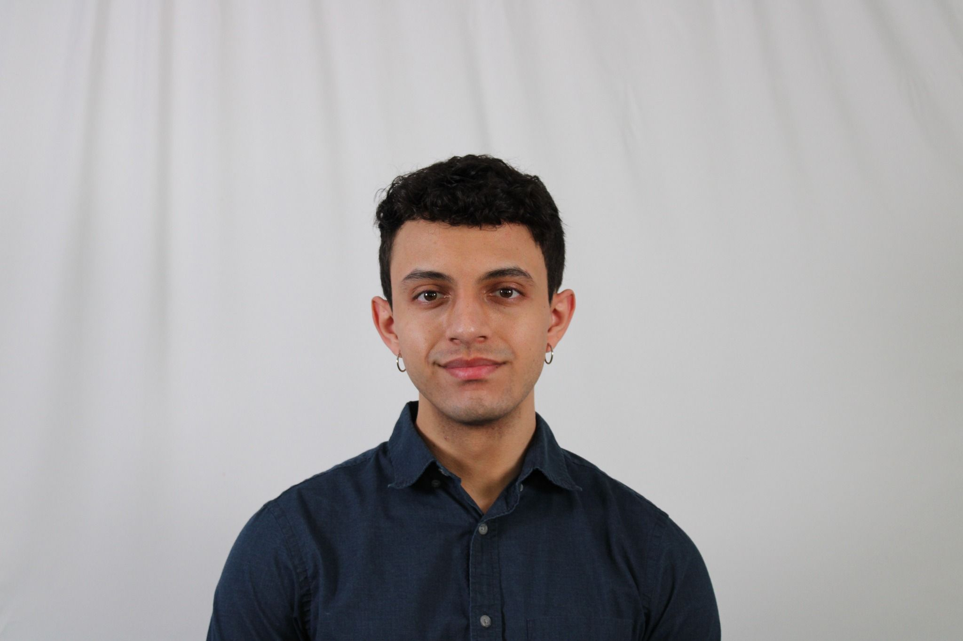
Intro to Speakers
Rhys Webb
Program Director
Karl Adrianza
Program Administrator

Slide 4

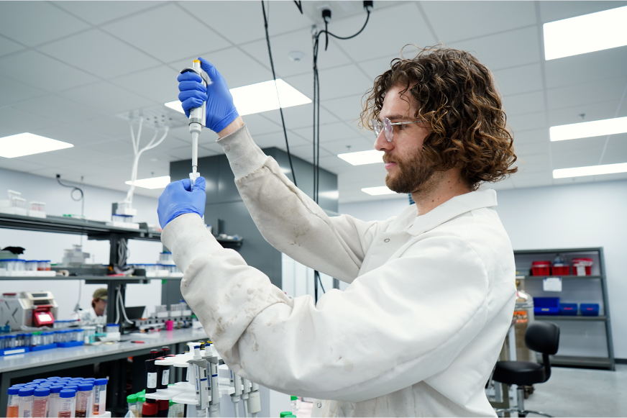


ACCELERATING
DECARBONIZATION
EMERGING CLIMATETECH
We contribute to meeting our state's ambitious climate goals by tackling barriers to widespread use of clean energy and climate technology in buildings, transportation,
and the grid.
We help new climate- focused businesses grow faster by backing a vibrant community of researchers, startups, and established industry players - creating an ecosystem where they connect and thrive.
MASSCEC’S WORK BY FOCUS AREA
LARGE SCALE DEPLOYMENT: OFFSHORE ENERGY
CLEAN ENERGY & CLIMATE WORKFORCE DEVELOPMENT
We're building a cutting- edge offshore energy industry, marshaling world-class ports while addressing supply
chain and workforce
development challenges.
We’re growing a diverse and
talented clean energy workforce by supporting a dynamic network of community-based organizations,
labor, training providers, schools and employers committed to a
sustainable future for all.
4

Slide 5
Maritime and Aviation Decarbonization Sector Mapping Initiative: Background and Goals
Background
To date, MassCEC’s transportation programming has focused on decarbonization of on-road vehicles; however, reducing emissions from the Maritime and Aviation sectors will be important steps in meeting state’s climate goals
Goals
Complement ongoing state agency efforts and centralize information
Proactively plan for future replacement and/or funding opportunities
Identify actionable, near-term next steps to strategically lay the foundation for long-term decarbonization efforts
Initiative Structure
Develop baseline sector map
Identifying key stakeholders
Existing decarbonization technologies
Supporting infrastructure
Relevant policy/regulatory measures in these sectors
Conduct robust stakeholder engagement with relevant industry entities to understand market needs, opportunities, and potential barriers
Develop a set of recommendations to identify near term (0-5 years) next steps for MassCEC and other MA state agencies to address barriers to Maritime and Aviation decarbonization
Pages
3-4
of the RFP

Slide 6
Initiative Parameters
For the purposes of this RFP, decarbonization may include:
Electrification
Renewable Fuels
Hydrogen
Other technologies/efficiencies that reduce emissions
Initiative will focus solely on recommendations to decarbonize vessels and aircraft, including analysis on relevant corresponding infrastructure (e.g. charging and fueling infrastructure)
Technical Consultant will not be expected to make recommendations on facilities, port or terminal infrastructure or off-road port or terminal vehicles
Initiative should focus on Maritime and Aviation decarbonization within Massachusetts
As needed, Technical Consultant may engage out-of-state (regional, national, international) stakeholders and reference relevant sector work happening outside of Massachusetts to contribute to the research and learnings
Pages
3-4
of the RFP

Slide 7
Scope of Work

Slide 8
Scope 1: Management and Reporting
Ongoing Management
Technical Consultant will be responsible for oversight of the Initiative and any communication between MassCEC, the Technical Consultant Team, and stakeholders. The Technical Consultant will be available for monthly Status Calls with MassCEC and will produce monthly Status Slide Decks.
Status Slide Decks
Key findings to date
Summary of stakeholder engagement and/or sector mapping progress
Challenges/barriers identified in executing Scopes of Work
Identification of next steps and action items
Quarterly Taskforce Meetings
Technical Consultant will be expected to lead a quarterly Taskforce Meeting comprised of MassCEC and other state agencies. The goal of the Taskforce is to coordinate with other state initiatives happening in these sectors, such as Massport’s SAF hub, and ensure agency agreement for the eventual Scope 4 recommendations.
MassCEC will identify Taskforce Members and Coordinate Taskforce convening.
Applicants should not identify or reach out to prospective Taskforce members.
Pages
5-6
of the RFP

Slide 9
Scope 2: Baseline Sector Mapping
Scope Summary
Technical consultant will develop an Initial Sector Map to establish a baseline understanding of the current maritime and aviation sectors in Massachusetts. Technical consultant will identify and Acquire Datasets necessary to inform the Initial Sector Map and subsequent Scope 4 recommendations.
Initial Sector Map
Key Stakeholders and Infrastructure
Identification of location and scale of existing ports and terminals in MA
Key stakeholders in the maritime and aviation sectors
Sub-sectors within the broader maritime and aviation sectors
Infrastructure and vessel/aircraft ownership models
Emissions Analysis
Analysis of current emissions levels from Maritime and Aviation sectors in MA
To include breakdown by sub-sector
Page
6
of the RFP

Slide 10
Scope 3: Sector Engagement and Finalized Sector Map
Scope Summary
Technical consultant will develop a Stakeholder Engagement Plan outlining proposed approach to engaging key stakeholders, with the goal of collecting a large volume of feedback from a diverse set of stakeholders. In addition, technical consultant will plan and execute in-person Roundtable Events for both the Maritime and Aviation sectors. Building on Scope 2 with stakeholder feedback, a Final Sector Map will be developed as a comprehensive tool identifying key stakeholders, relevant regulations and policy, and available and upcoming technologies. Consultant will work with MassCEC and the Executive Office of Energy and Environmental Affairs ("EEA") to assist with the development of the maritime and aviation sections of the 2035 Clean Energy and Climate Plan (“CECP”).
Roundtable Events
To collect initial information on current decarbonization efforts in Maritime and Aviation sectors, including barriers, successes and opportunities, as well as feedback and ideas for potential future decarbonization efforts.
Final Sector Map
Regulations and Policies
Existing Early/Growth Stage Technologies
Barrier identification
Non-MA Initiatives
Potential Focus Areas
Workforce Needs
Emissions Reduction Potential
Pages
6-9
of the RFP

Slide 11
Scope 4: Development and Communication of Recommendations
Scope Summary
Technical Consultant will produce a set of Draft Recommendations identifying short- and medium-term (0-5 years) next steps to begin decarbonizing the Maritime and Aviation sectors. A presentation of these Draft Recommendations will be develop to share with MassCEC and other key state agencies. This will be followed by a feedback session with the state agencies, as well as another series of Roundtable events for Maritime and Aviation sectors. Incorporating feedback, technical consultant will develop a set of Final Recommendations for actionable short- and medium-term next steps.
Draft Recommendations
Recommendations should be specific, actionable and within the jurisdiction of MA state entities
Recommendations for MassCEC should be directives, while recommendations involving participation from other agencies should be exploratory
Final Recommendations
Incorporating feedback gained from previously held roundtables and state agency engagement, technical consultant will be develop a presentation of the final recommendations and present findings to additional relevant entities as needed, including non-state agency stakeholders previously engaged.
Presentations will include a Maritime-focused and Aviation-focused webinar to be recorded and distributed as needed
Pages
9-11
of the RFP

Slide 12
Application Details

Slide 13
Budget and Eligibility
Budget
Applicants should propose clearly elaborated and justified budgets associated with the primary Scopes of Work and corresponding Tasks.
Applicants should include a detailed breakdown of all relevant assumptions that informed budget development
Technical Consultant will be paid on a milestone basis based on a deliverables schedule.
Eligible Applicants
MassCEC is open to Applicant Teams that include multiple firms. Applicant teams will work together on a proposed project with one entity designated as the Lead Applicant
Pages
4 & 14
of the RFP

Slide 14
Application Resources
MassCEC will accept questions on a rolling basis until April 8, 2026.
Answers will be posted to website on a rolling basis until April 15, 2026
Submit all questions to CleanTransportation@MassCEC.com with “Sector Mapping RFP Questions” in the subject line
Please visit the MassCEC Sector Mapping RFP Webpage for more information regarding the program
Join our mailing list to be notified of other opportunities
A recording of the webinar will be posted to the webpage following the event
Join the Slack channel to network/meet other prospective Applicants and form Applicant teams
Pages
15
of the RFP

Slide 15
How to Apply
Application Details
Submit a completed proposal, not including recommendation letters. The submission must be in electronic form (one PDF file), including all relevant attachments, submitted via email to CleanTransportation@MassCEC.com. “Sector Mapping RFP” must appear in the e-mail subject line.
Submission packages
Applicant’s Signature and Acceptance Form
Executive Summary
Proposal, including:
Statement of Qualifications
Workplan Narrative
Project Schedule
Budget and Rate Sheet
References
Team Member Resumes (as an appendix)
Page
12
of the RFP

Slide 16
Application Timeline
May 1, 2026
Maritime and Aviation Sector RFP Applications due
April 15, 2026
March 26, 2026
Questions due to MassCEC via email to CleanTransportation@MassCEC.com by 4:00 PM ET.
March 20, 2026
Release of RFP
Mid-May 2026
Webinar
Opportunity to review RFP material, submit questions, etc.
Questions with Answers Posted to the Sector Mapping Webpage
April 8, 2026
Interviews (if necessary) and award decision in Early June 2026
Submit by 4:59 PM ET. to CleanTransportation@MassCEC.com
Pages
5
of the RFP

Slide 17
FAQs
Can I apply if my Applicant Team is not all MA-based?
Yes, but experience working in MA maritime and aviation sectors is encouraged.
What is the term length of the program?
Contracting will be completed by Early June 2026
Work is expected to begin September 2026
No fixed term length; the project will continue until completed, per the contract
All funds will be paid to the Technical Consultant on a milestone basis based on a deliverables schedule
What are the allowable expenses for this Initiative?
This funding is intended for research activities only and does not support implementation activities.
What outreach has MassCEC done already?
MassCEC has coordinated with other state agencies, specifically Massport and MassDOT. We have also had conversations with regional airports and airlines, non-profit research institutes, academic institutes, and technology providers. A contact list will be provided to the selected consultant.

Slide 18

Thanks for Joining Us! CleanTransportation@MassCEC.com

