Slide 1
40101(d) Federal Formula Funding 2026 Kickoff Meeting
Massachusetts Clean Energy Center

Slide 2
Massachusetts Clean Energy Center
  MassCEC was established by Chapter 23J of the General Laws and began operating in 2009.
  MassCEC is a quasi-public state economic development agency dedicated to accelerating the growth of the clean energy sector across the Commonwealth to spur job creation, deliver statewide environmental benefits and to secure long-term economic growth for the people of Massachusetts. MassCEC works to increase the adoption of clean energy while driving down costs and delivering financial, environmental, and economic development benefits to energy users and utility customers across the state.
  MassCEC’s mission is to accelerate the clean energy and climate solution innovation that is critical to meeting the Commonwealth’s climate goals, advancing Massachusetts’ position as an international climate leader while growing the state’s clean energy economy.
About:

Slide 3
40101(d) Program Background
Federal Program
MA Program
Section 40101(d) of the Bipartisan Infrastructure Law -“Preventing Outages and Enhancing the Resilience of the Electric Grid”​
Formula funding opportunity​
The funding aims to:
MassCEC distributed almost $10 million during the first round of the program in 2024​
MassCEC has approximately $3 million remaining to distribute under this RFP ​
MassCEC and DOER developed the program to:​
This round includes a focus on microgrid development
Enhance the resilience of the electric grid
Improve energy resilience and reliability
Prevent outages
Support state decarbonization efforts
Create good-paying jobs
Mitigate the impact of disruptive events

Slide 4
Current Program Status
Aug 2023 – April 2024
2025
MassCEC received FY22 – FY24 awards from DOE and conducted public comment on program design.
Awards were made from first solicitation and projects began
July – Oct 2024
June 22, 2026
MassCEC release the first RFP under this program and received applications.
MassCEC released the round 2 RFP under this program

Slide 5
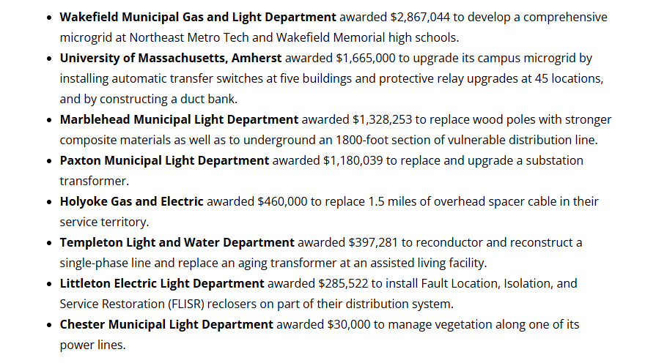
First round subrecipients

Slide 6
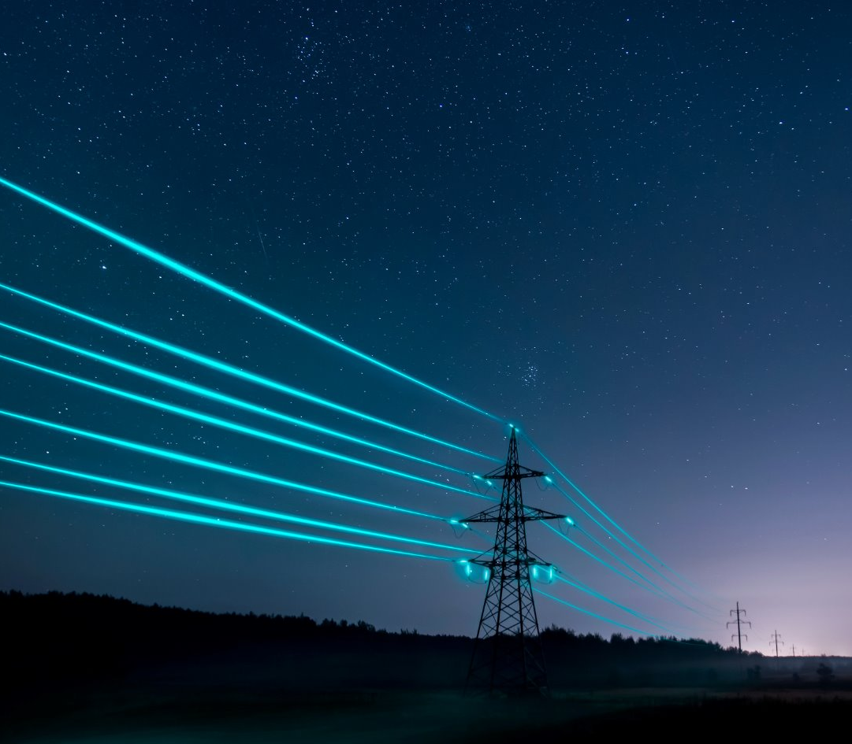
Program Eligibility
Eligible Subrecipients:
Electric grid operators;​
Electricity storage operators;​
Electricity generators;​
Transmission owners or operators;​
Distribution providers;​
Fuel suppliers; and​
Any other relevant entity, as determined by the Secretary of DOE

Slide 7
Program Eligibility
Eligible Activities:
Weatherization technologies and equipment;​
Fire-resistant technologies and fire prevention systems;​
Monitoring and control technologies;​
Undergrounding of electrical equipment;​
Utility pole management;​
Relocation of power lines or the reconductoring of power lines with low-sag, advanced conductors;​
Vegetation and fuel-load management;
Use or construction of distributed energy resources (DERs) for enhancing system adaptive capacity during disruptive events, including:​
  microgrids; and​
  battery-storage subcomponents​
Adaptive protection technologies;​
Advanced modeling technologies;​
Hardening of power lines, facilities, substations , or other systems; and​
Replacement of old overhead conductors and underground cables.

Slide 8
Cost Match
Cost Match Requirements
Cost match is required for all subrecipients per federal requirements​
Large entity cost match – 115% of award​
Small entity cost match – one third (1/3) + 15% of award ​

Slide 9
MassCEC Program Priorities
Microgrid Development
MassCEC has a preference for projects that enable or support microgrid development, with a focus on those located at critical facilities. Some examples of potential projects: ​
  Installation of automatic transfer switches​
  Installation of switchgear or other microgrid controls​
  Upgrades to the local distribution system that are needed to enable microgrid
  Battery Energy Storage Systems that provide support during disruptive events (must comply with Build America, Buy America requirements without the use of a waiver)

Slide 10
Program Application Expected Timeline
2 – 4 weeks post submission
Likely 4-6 months after projects are submitted to DOE for review
July 15th, 2026
August 28th, 2026
Initial Questions and Answers posted to MassCEC webpage, will be updated periodically.
All questions due to grid@masscec.com
Interviews with top applicants (if needed)
Award notification, dependent on DOE review timeline.
September 21st, 2026
6 – 8 weeks post submission
August 4th, 2026
MassCEC will be hosting a microgrid convening event from 10:30am – 12pm virtually
Proposals due to grid@masscec.com
Recommended projects submitted for DOE approval.

Slide 11
Application Materials
MassCEC Requirements
Federal Requirements
Attachment A – Application Form​
Attachment B - Signature and Acceptance Form​
Attachment C - Project Narrative​
Attachment D - Project Workplan​
Attachment E - Budget Justification Workbook​
Attachment F - Proposed Project Metrics​
Attachment G - Cost Match Commitments and Support Letters with Cover Pages (submit as many as needed, optional)
NEPA Environmental Questionnaire​
Foreign Nationals Participation form​
Build America Buy America (BABA) waiver request (If applicable)​
Performance of Work in the US waiver (if applicable)​
Domestic Entity waiver for subrecipients (if applicable)

Slide 12
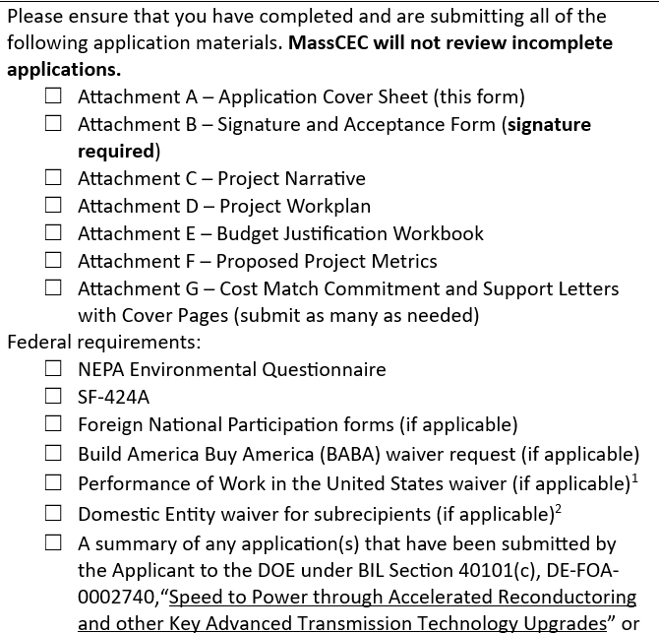
Application Materials
List of required materials:
Screenshot from Attachment A:
Please refer to page 1 in Attachment A – Application Form for the full list of required materials to be submitted.

Slide 13
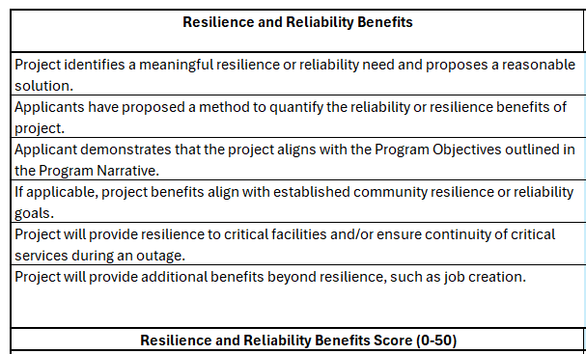
Application Materials
Reference Materials
Attachment H Example
The below listed materials are linked on the 40101(d) webpage for informational purposes only. They are not required for the application.​
​
  Attachment H - Scoring Rubric​
  Attachment I - Quarterly Progress Report Template​
  Attachment J - Annual Reporting Template​
​
  Attachment K – Grant Agreement Template

Slide 14
Federal Program Requirements
Federal Flow Down Requirements
MassCEC Support
Davis Bacon Act and Prevailing Wages
Build America, Buy America
Quarterly Reporting
Annual Reporting, for two years past project completion
Program compliance consultant to help subrecipients
Pages 7 – 11 of the RFP explain these requirements and reference further sources with more details

Slide 15
Questions
Submit Questions
Ask Questions Live
Please submit all written questions to grid@masscec.com ​
Questions must be submitted by the EOD on August 28th, 2026
Answers to all questions will be posted on the 40101(d) webpage beginning on July 15.
The Q&A section will be updated periodically throughout the application period as additional questions come in.​
Relevant Q&A from the first round remains available on our website.
Write comments/questions in the chat​
Use the “raise hand” function to ask a question

Slide 16
THANK YOU

