Slide 1
MassCEC On-Street Charging Solutions Program
Webinar

Slide 2
Agenda
Program overview
Timeline
Application
Q&A

Slide 3
Program Overview
Massachusetts Clean Energy Center (MassCEC) awarded CET a two-year contract for its On-Street Charging Solutions Program.
Program term: November 2024 – December 2026
The Program will support On-Street EV Charging in two ways:
Planning Support and Feasibility Studies
On-Street Charging Infrastructure Installations
Emphasis on providing EV Charging access to LIDACs.
CET is partnering with Leidos, FLO Charging, and others on the project.

Slide 4
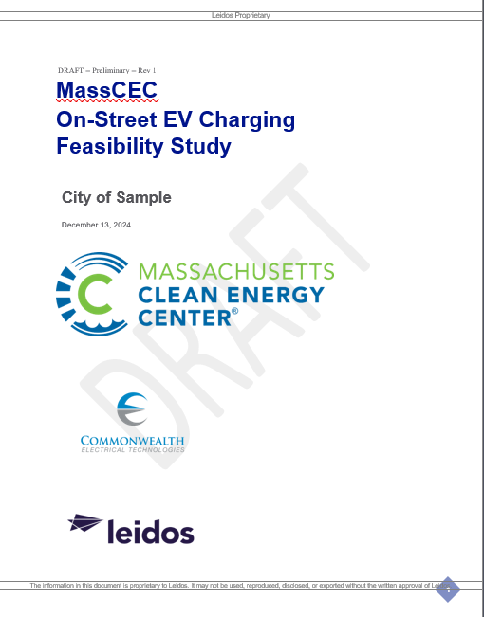
Offering #1: Planning Support & Feasibility Studies
Up to 25 Municipalities will receive Feasibility Study Reports at no cost.
Includes recommendations for charging locations, EVSE ownership structure, maintenance, parking enforcement, etc.
Incorporates stakeholder and community input
Estimates cost and timeline to complete installation

Slide 5
Offering #2: On-Street EV Charging Project Implementation
Up to 15 Municipalities will receive EV charging infrastructure projects.
CET will design, procure, and install on-street EV charging projects at no cost.
Incorporates stakeholder and community input
Not using Eversource/NGRID/MassEVIP Programs

Slide 6
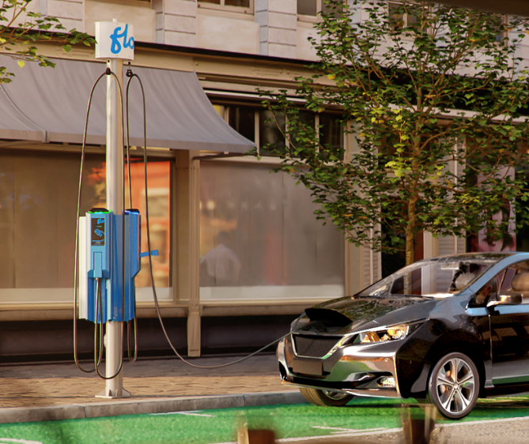
Expedited Pathway
Cookie-cutter design options for fastest project deployment
2-5 FLO SmartTWO dual-port Level 2 pedestal charging stations (charge from empty to 80% in ~4 to 8 hours)
Traditional ownership model
Will allow for ~3 charging sites per municipality

Slide 7
Custom Pathway
Municipalities can opt for alternative solutions that better fit their needs:
EVSE quantity (>10 ports)
Speed (>7kW per port)
Mounting (pole-mounted, etc.)
Manufacturer
Ownership model (lease or third-party owned)
May result in longer timeline.

Slide 8
Timeline
Intro call (if needed)
Submit application – Jan/Feb ‘25
If selected, sign Memorandum of Understanding – March ‘25
Kickoff Meeting – April ‘25
Community Outreach – May ‘25
Preliminary Site Selection & On-Site Assessments – June ‘25
Offering #1: Leidos will complete Feasibility Study Report & Presentation – by Sep ‘25
Offering #2: CET will complete project design, permitting, construction, commissioning, and O&M Plan – by Nov ‘26
Notes:
Offering 1: will need muni staff support with
Kickoff meeting
Follow-on meetings to develop Work Plan and Community Outreach Plan
Community outreach
Site selection
On-site assessments
Offering 2: will need muni staff support with
Kickoff meeting
Follow-on meetings to develop Work Plan and Community Outreach Plan
Community outreach
Site selection
On-site assessments
Project design approvals
Permitting
* Projects like this work best when there is one POC / champion at the municipality who can help push things forward

Slide 9
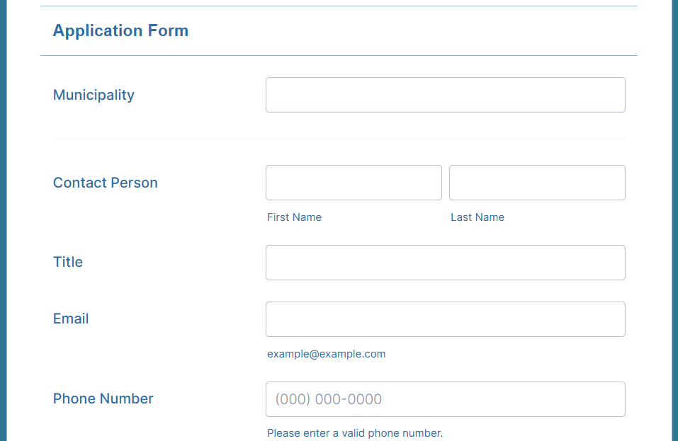
Program Application
Applications are being accepted now: https://form.jotform.com/243544124042042
You can specify which offering you are interested in: Project Implementation, Feasibility Study, or both (can only be selected for one or the other)
Deadline: 5pm Friday, February 14th, 2025

Slide 10
Final Thoughts
Terrific opportunity, but we are on an aggressive timeline that we need your help to meet!
Very collaborative process with heavy community engagement
Ideal communities
Low Income / Disadvantaged Communities
Large renter population, lots of on-street parking
If you are not selected for Implementation, you may still be selected for a Feasibility Study

Slide 11
Q&A

Slide 12
Contact
Steven Conte
On-Street Program Manager, CET
sconte@comelectrical.com
401-484-2853

Slide 13
Thank you!

