Slide 1
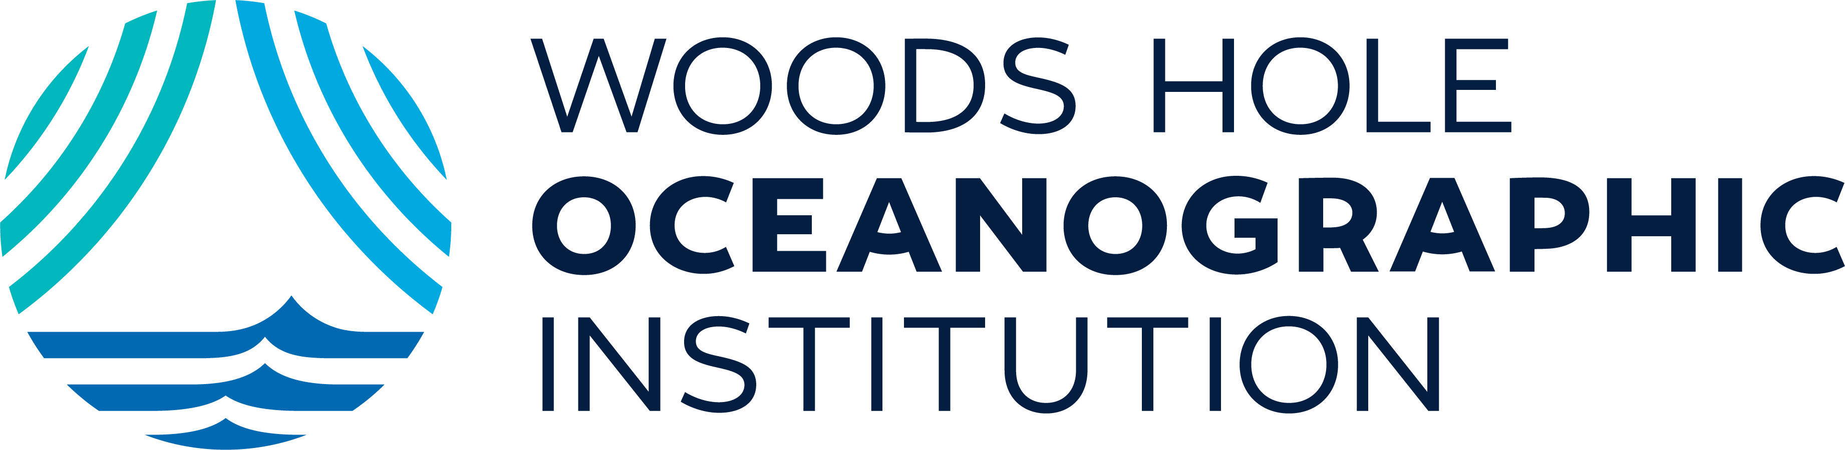

Woods Hole Oceanographic Institution
Woods Hole Oceanographic Institution (WHOI) is the world’s leading independent nonprofit dedicated to advancing ocean science, engineering, and technology. WHOI is renowned for pioneering innovations in autonomous underwater vehicles (AUVs) and for operating one of the most advanced fleets of research vessels and submersibles. The institution has a strong track record of translating research into practice, with technologies licensed for commercial use and several spinout companies emerging from its labs. WHOI’s collaborative model—partnering with academia, government, and industry—accelerates innovation in areas like offshore renewable energy, ocean carbon removal, and marine resource management. WHOI’s commitment to ocean discovery and impact makes it a cornerstone of Massachusetts’ ocean technology ecosystem and a vital contributor to the global blue economy.
Website
Contact

Slide 2
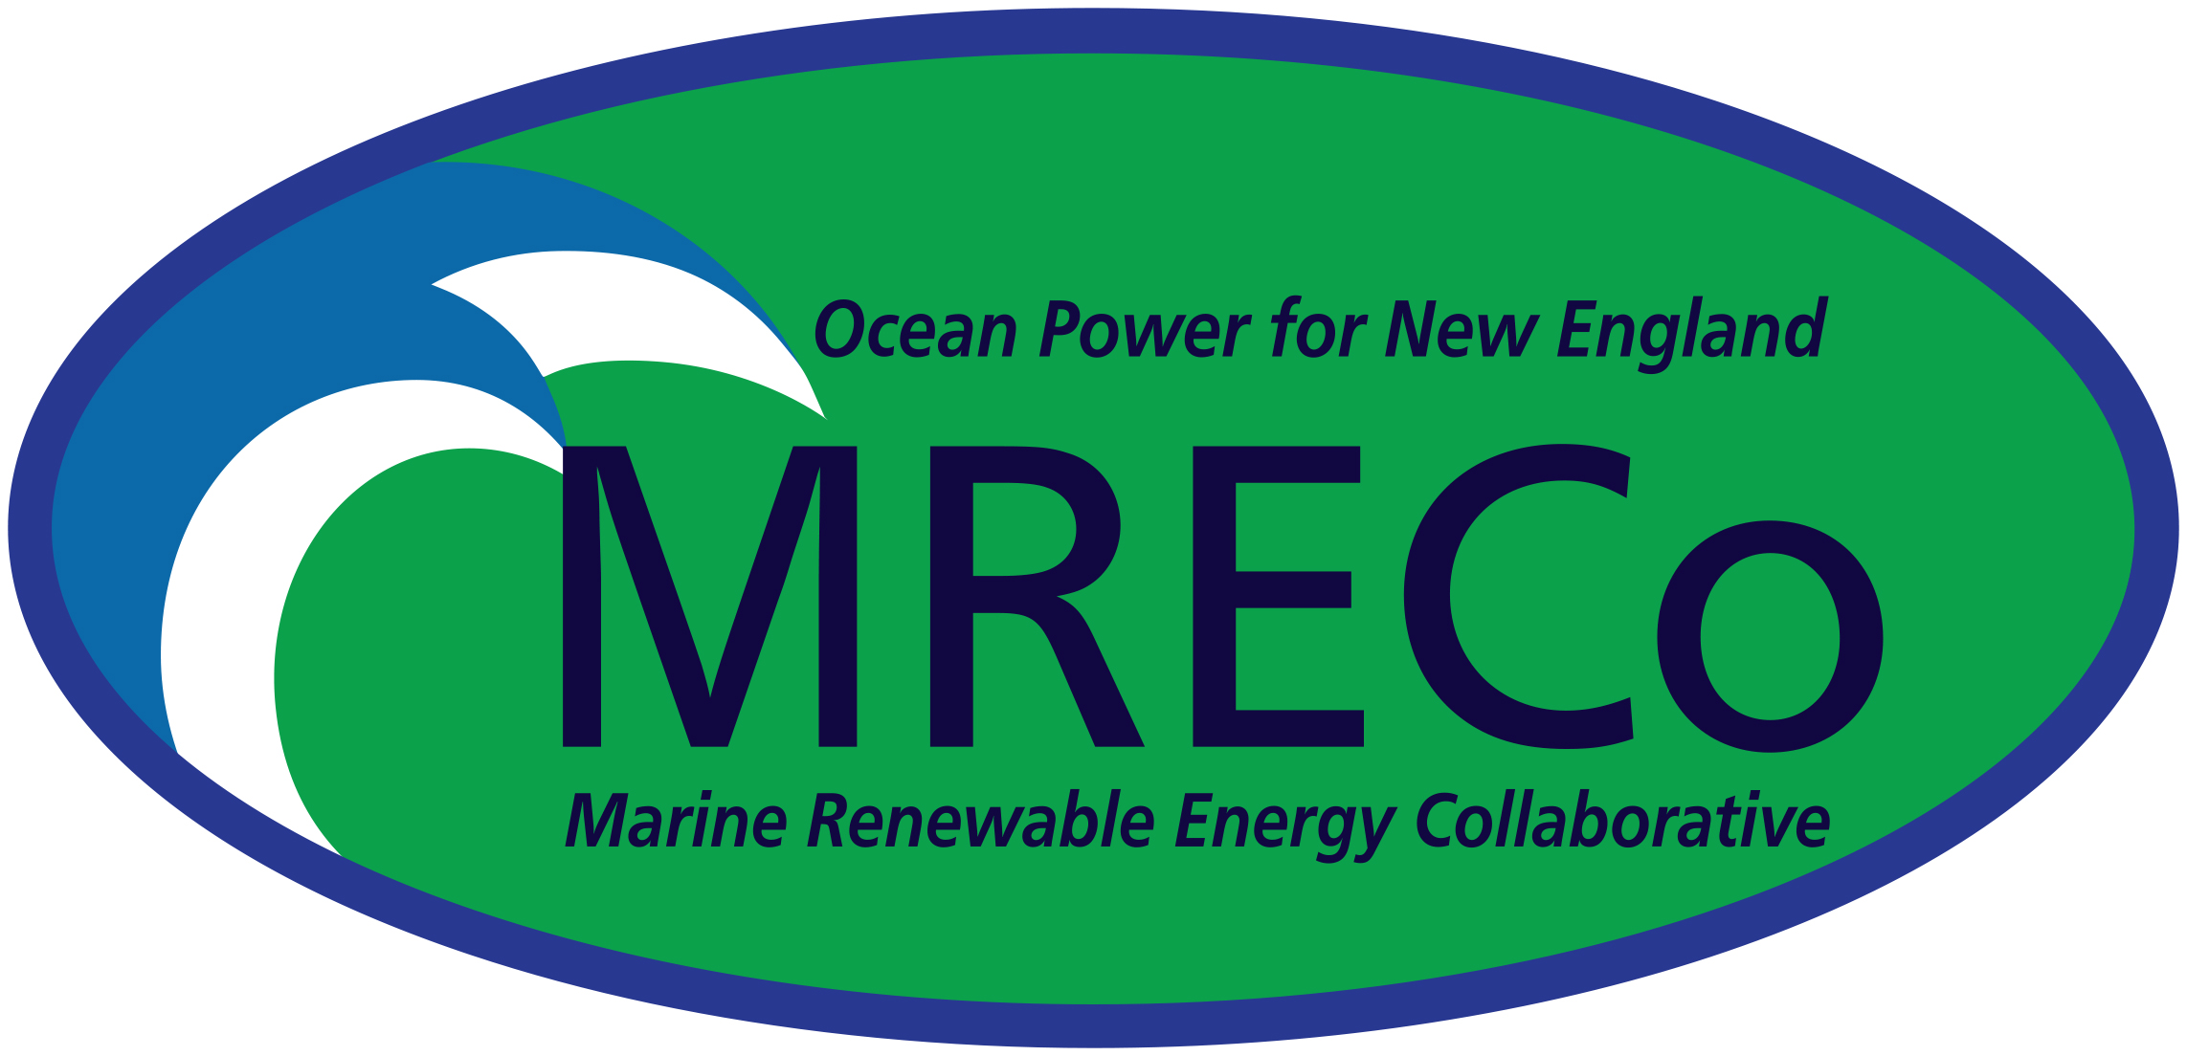
Marine Renewable Energy Collaborative
The Marine Renewable Energy Collaborative of New England (MRECo) is a non-profit dedicated to sustainable development of ocean renewable energy. Testing prototypes is critical to ensure performance and to assess environmental impact. Permitting is complex and test cost is a high barrier to market entry. MRECo’s answer? Pre-permitted test sites. The Bourne Tidal Test Site platform provides stability to test turbines and sensors. It is fully permitted and FERC licensed. The Cuttyhunk Test Area, under development, tests wave devices and sensors. The goal? Near Lab Control in Ocean Waters.
Website
Contact

Slide 3
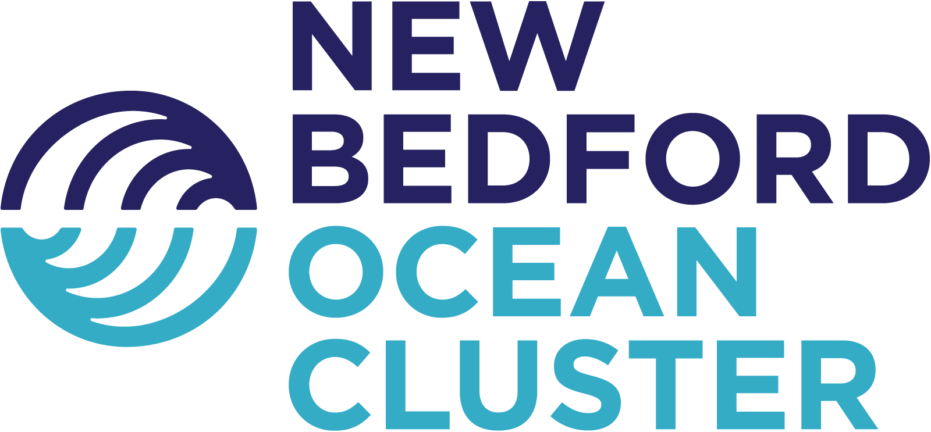
New Bedford Ocean Cluster
New Bedford Ocean Cluster (NBOC) is a nonprofit, marine industry association created to leverage the Port of New Bedford and surrounding region’s strategic coastal position and extensive ocean economy and knowledge base to attract investment, support the formation and growth of maritime businesses, and foster initiatives that can create economic impact. NBOC fosters collaboration and coordination across industry, academia, and the public sector to promote and grow the region’s maritime economy across four, interrelated industries: Aquaculture, Commercial Fishing & Processing, Offshore Renewable Energy, and Marine Innovation & Technology.
Website
Contact

Slide 4
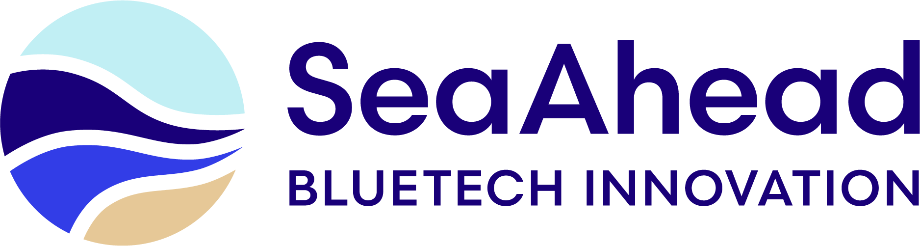
SeaAhead
SeaAhead invests both time and capital into early-stage bluetech startups to generate outsized venture returns and ocean impact. We work with founders who seek to change the way we do business in order to drive positive environmental, economic, and social outcomes. Using a blended capital model, we run high-quality acceleration programs supported by philanthropic donors and corporate sponsors, and then use investment to scale the most promising startups.
Website
Contact

Slide 5
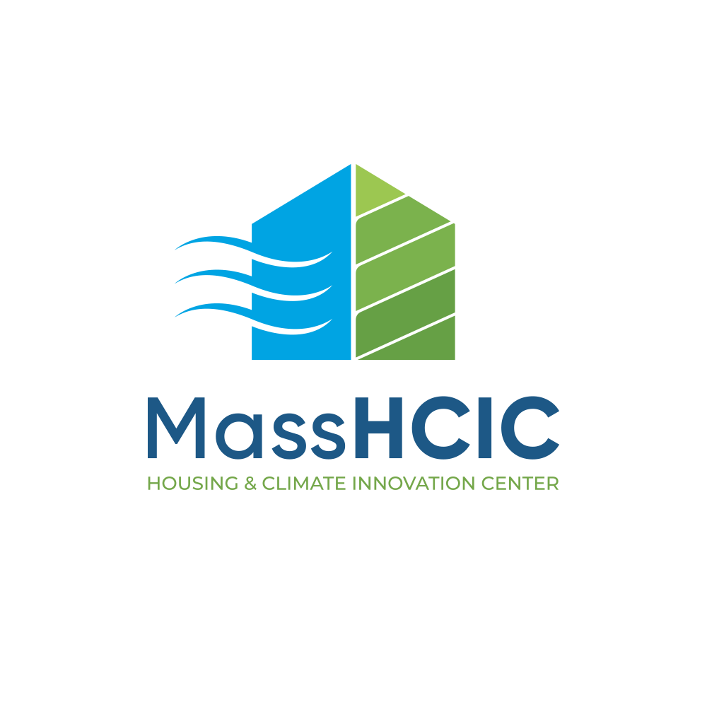
Massachusetts Housing and Climate Innovation Center
MassHCIC, a 501(c)(3) founded in 2023, advances affordable, net-zero housing that is resilient to climate change. Partnering with Cape Cod’s 15 towns, it leverages municipal assets as testbeds for climate, housing, tough and ocean tech that support adaptation and safeguard fragile ecosystems.
Formed by a coalition of colleges, developers, industry, and government, MassHCIC drives collaboration, providing startups with expertise, resources, and real-world sites to pilot innovations that protect communities and the environment.
Website
Contact

Slide 6
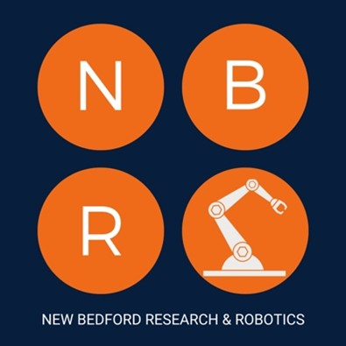
New Bedford Research and Robotics
New Bedford Research & Robotics (NBRR) is a non-profit 501c3 organization that serves as a physical hub for entrepreneurship, prototyping, education, and skills development in the marine technology sector. NBRR offers access to extensive resources, including its 33,000-square-foot facility, robotics technologies, and engineering staff. Strategically located in the Port of New Bedford, directly across from the new train to Boston, NBRR leverages its proximity to the deepwater port. Its mission is to leverage technology for cross-sector collaboration to drive community and economic outcomes. NBRR provides certified industrial and marine robotics workforce training programs and fosters innovation through its "five-channel ecosystem" encompassing industry R&D, startup incubation, university research, STEM education, and community engagement.
Website
Contact

Slide 7
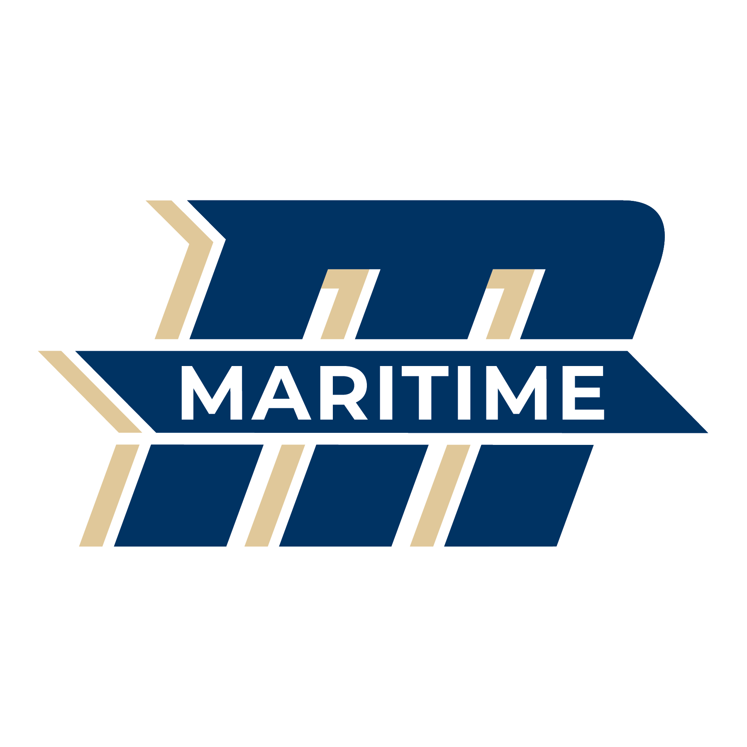
Massachusetts Maritime Academy
Massachusetts Maritime Academy, home to the Marine Center for Renewable Energy, is a national leader in offshore wind training and ocean technology. Through cutting-edge programs and industry partnerships, MMA prepares cadets and professionals for careers in renewable energy, maritime operations, and the blue economy all leading to the advancement of workforce development and innovation to meet the demands of a changing ocean and energy landscape.
Website
Contact

Slide 8

Umass Dartmouth
UMass Dartmouth is a hub for Blue Economy innovation, advancing sustainable fisheries, offshore wind, coastal resilience, and ocean technology. Anchored at its School for Marine Science & Technology on Clark’s Cove in New Bedford—the nation’s top value fishing port—the university offers ocean modeling capabilities, and unique ocean tech testing facilities from seawater labs, acoustic-optic tanks, autonomous underwater vehicles, and an upcoming cutting-edge flume tank. From pioneering offshore energy systems to developing next-generation battery materials, UMass Dartmouth turns research into real-world impact while preparing exceptional talent to fuel a sustainable ocean and energy economy.
Website
Contact

Slide 9
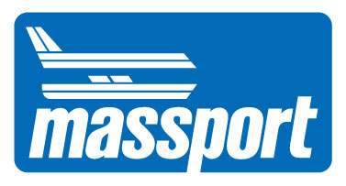
Massport
The Massachusetts Port Authority (Massport) plays a crucial economic development role in Massachusetts and the broader New England region. With a variety of facilities in Boston Harbor and deep relationships across the maritime industry, Massport is working to strengthen the local blue economy and make Boston a global destination for blue businesses. Looking for harbor access, waterfront workspace, or industry connections? Massport welcomes collaboration with innovators, entrepreneurs, and investors who share our vision for a vibrant, resilient maritime future. Reach out today to learn more about potential partnership opportunities: realestate@massport.com
Website

Slide 10
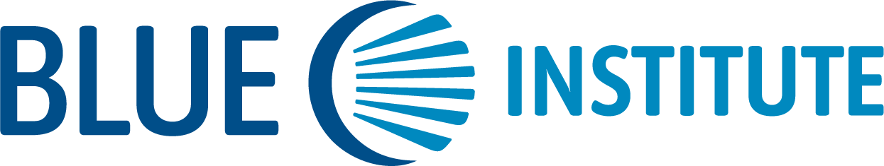
Blue Institute
Blue Institute is a nonprofit 501c3 dedicated to creating solutions for climate challenges. Home to the BLUE Excelerator (BX), it is an “Advanced Topics” virtual three-month program for BlueTech, ClimateTech, and Blue Economy startups – taking a deep dive into design, development, and deployment of pilots & prototypes with industry mentors and expert speakers.
BX has graduated 49 startups and is opening the sixth cohort BX6 application at the end of October 2025. For its 10th anniversary in 2026, Blue Institute is organizing the global Climate Week Blue.
Wbsite
Contact

Slide 11
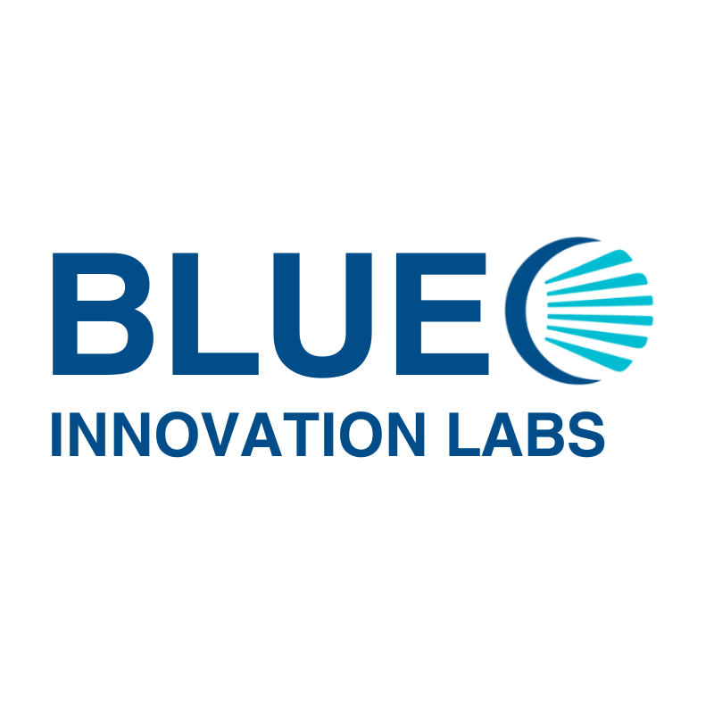
Blue Innovation Labs
Blue Innovation Labs, located on Boston Harbor, is the first ocean tech hub on the US eastern seaboard. Home to the BLUE Incubator, a bespoke one-three-year platform for BlueTech & ClimateTech startups, has 30 alumni with over $35 million raised, and dozens of jobs created.
Specialized wrap around services, funding access, in-situ testing, dual-use and technical support to bridge the "Valley of Death" to commercialization. Regional and national network partnerships and globally through membership in the World Economic Forum’s 1000 Ocean Startups coalition.
Website
Contact

Slide 12

VentureWell
VentureWell is a non-profit organization with a mission to foster science and technology innovation and entrepreneurship addressing the most pressing challenges facing people and the planet. Over 30 years, we’ve trained and supported more than 19,000 innovators representing over 5,800 ventures that have raised over $7B in private and public investment.
Through VentureWell’s Ocean Enterprise Accelerator program, we are supporting founders developing and commercializing new ocean technology for economic and societal benefit to the U.S. and our blue economy. Visit https://venturewell.org/ocean-enterprise-accelerator/ for info and deadlines.
Website

Slide 13
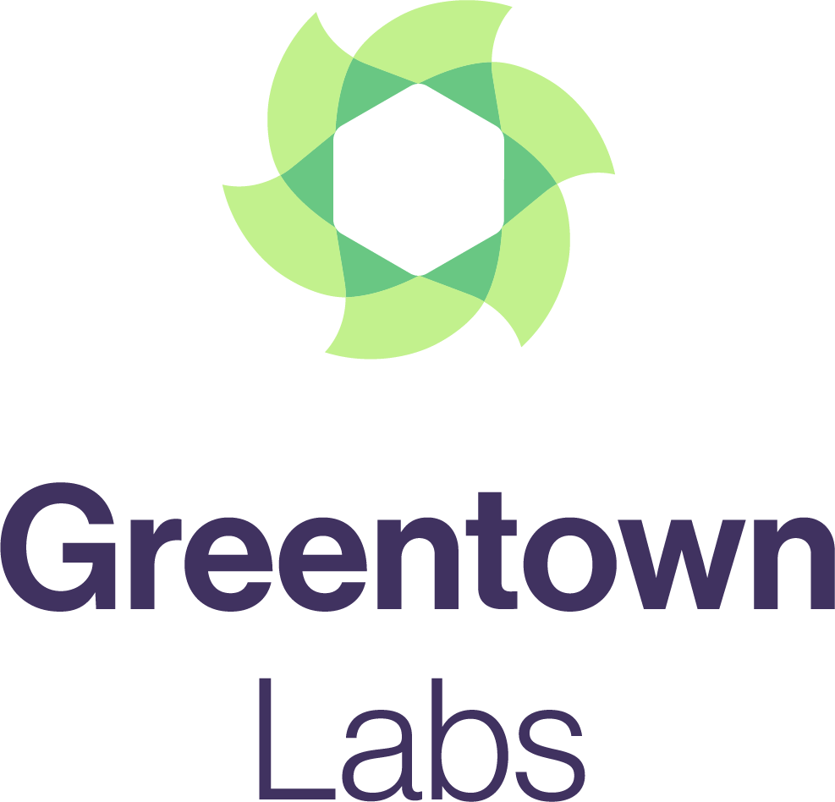
Greentown Labs
Greentown Labs (Somerville, MA) is the largest climatetech incubator in the world, offering prototyping resources and a powerful network of partners to support startups in addressing the climate crisis. Greentown plays a vital role in advancing ocean and blue tech innovation by providing the tools and community needed to scale technologies through in-lab development—helping entrepreneurs de-risk solutions that leverage marine resources or sustain marine environments. Since 2011, Greentown has supported 600+ startups that have raised $8.2B+ and created 13,500+ jobs.
Website
Contact

Slide 14
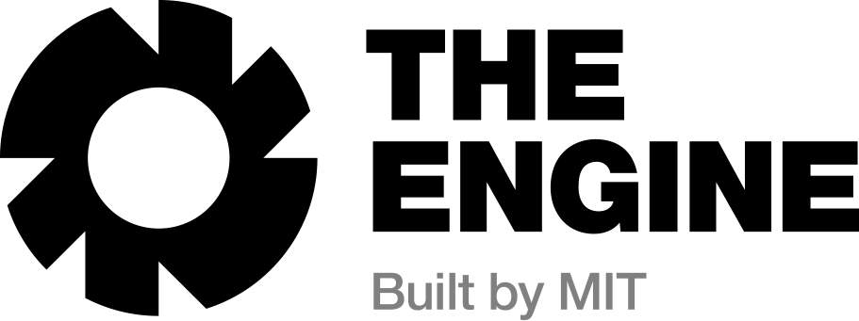
The Engine
The Engine is a nonprofit incubator that helps Tough Tech teams—working at the intersection of science and engineering—scale breakthrough solutions to the world’s hardest problems. Located in Cambridge, we support ocean tech startups with lab space, industry expert advisors, policy and public affairs guidance, and investor and industry connections. Our ecosystem helps founders advance innovations in sensing, robotics, energy, and marine systems from lab to ocean, accelerating impact in the blue economy.
Website
Contact

