Slide 1
School Bus Electrification: Overview and Funding Opportunities
November 2, 2022
Jade lu (masscec), Orly strobel (masscec), and gary rennie (epa Region 1)

Slide 2
Agenda
Introduction
Electrification 101
Overcoming Barriers to Electrification in the Commonwealth
Navigating the Electric School Bus Funding Landscape
Open Q&A

Slide 3
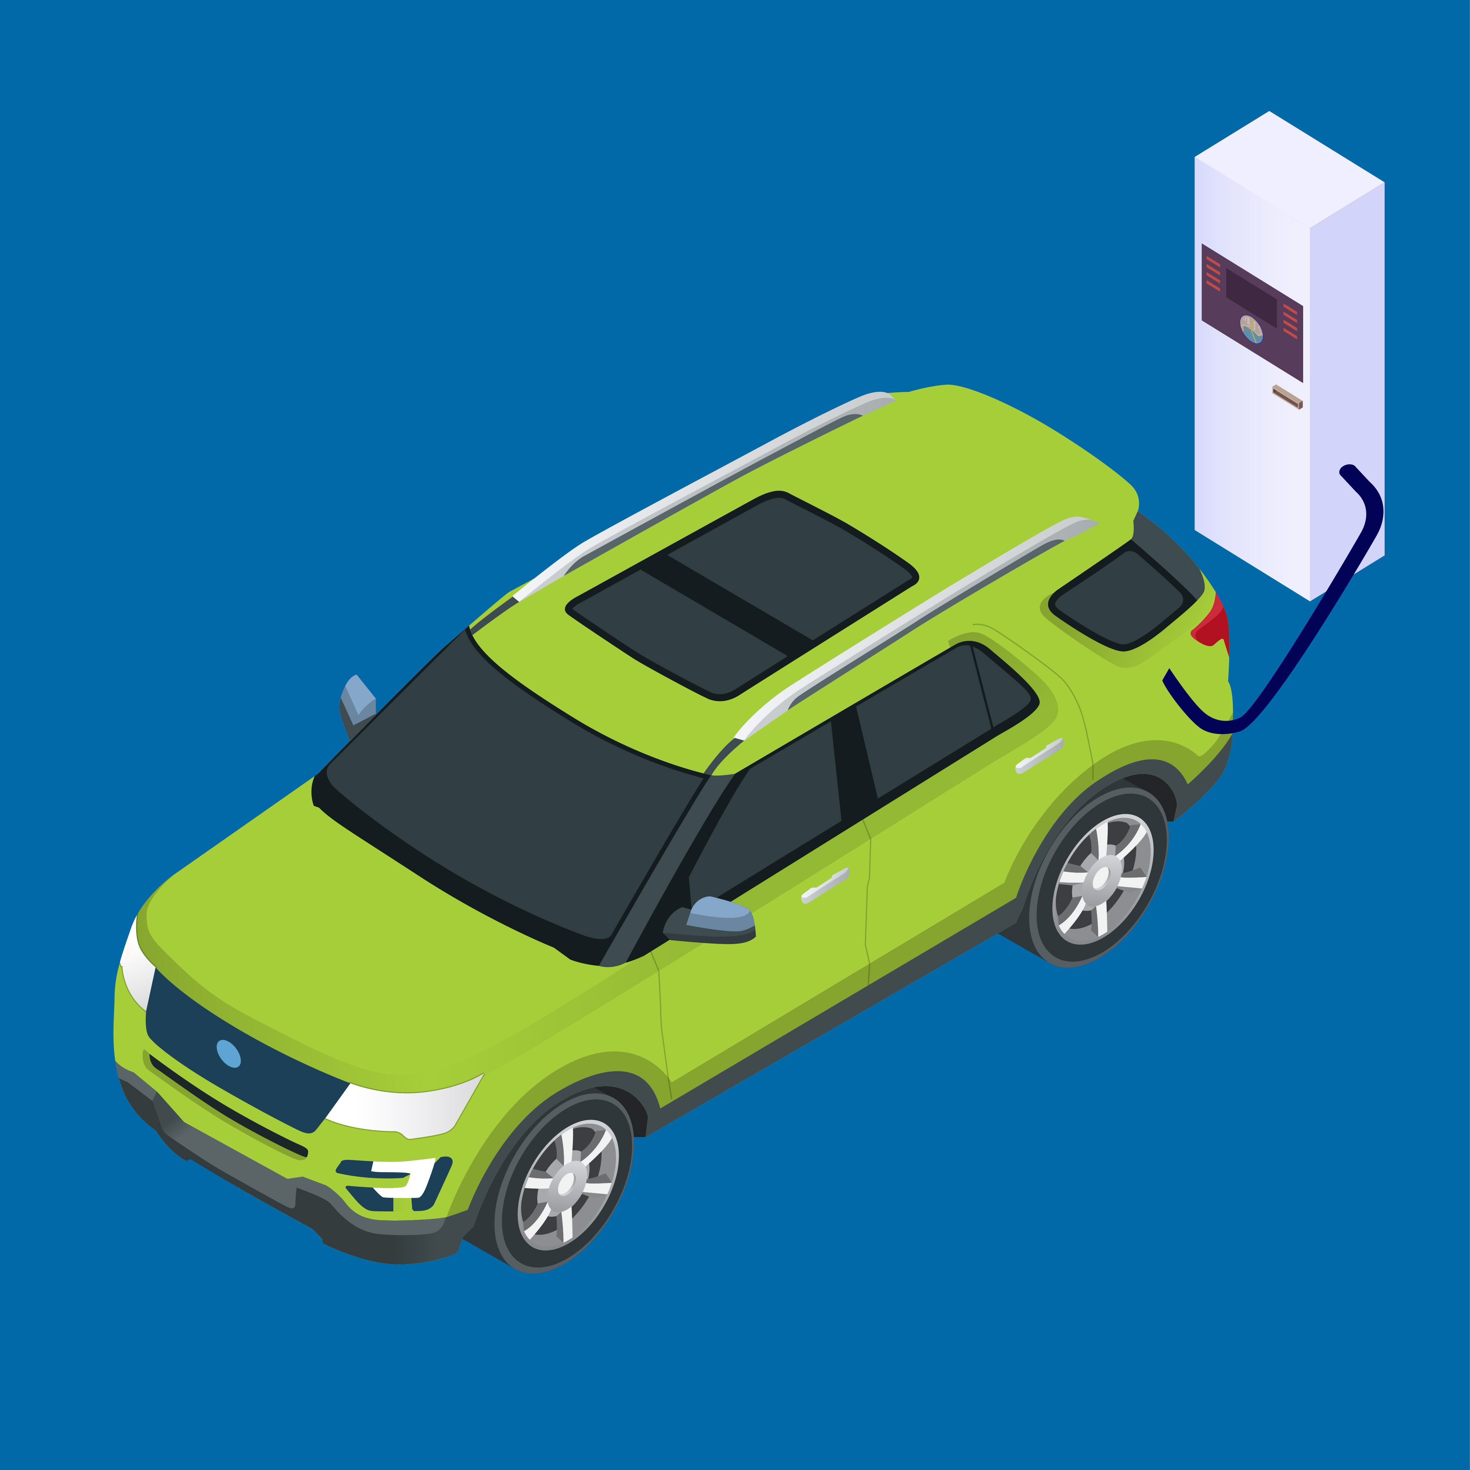
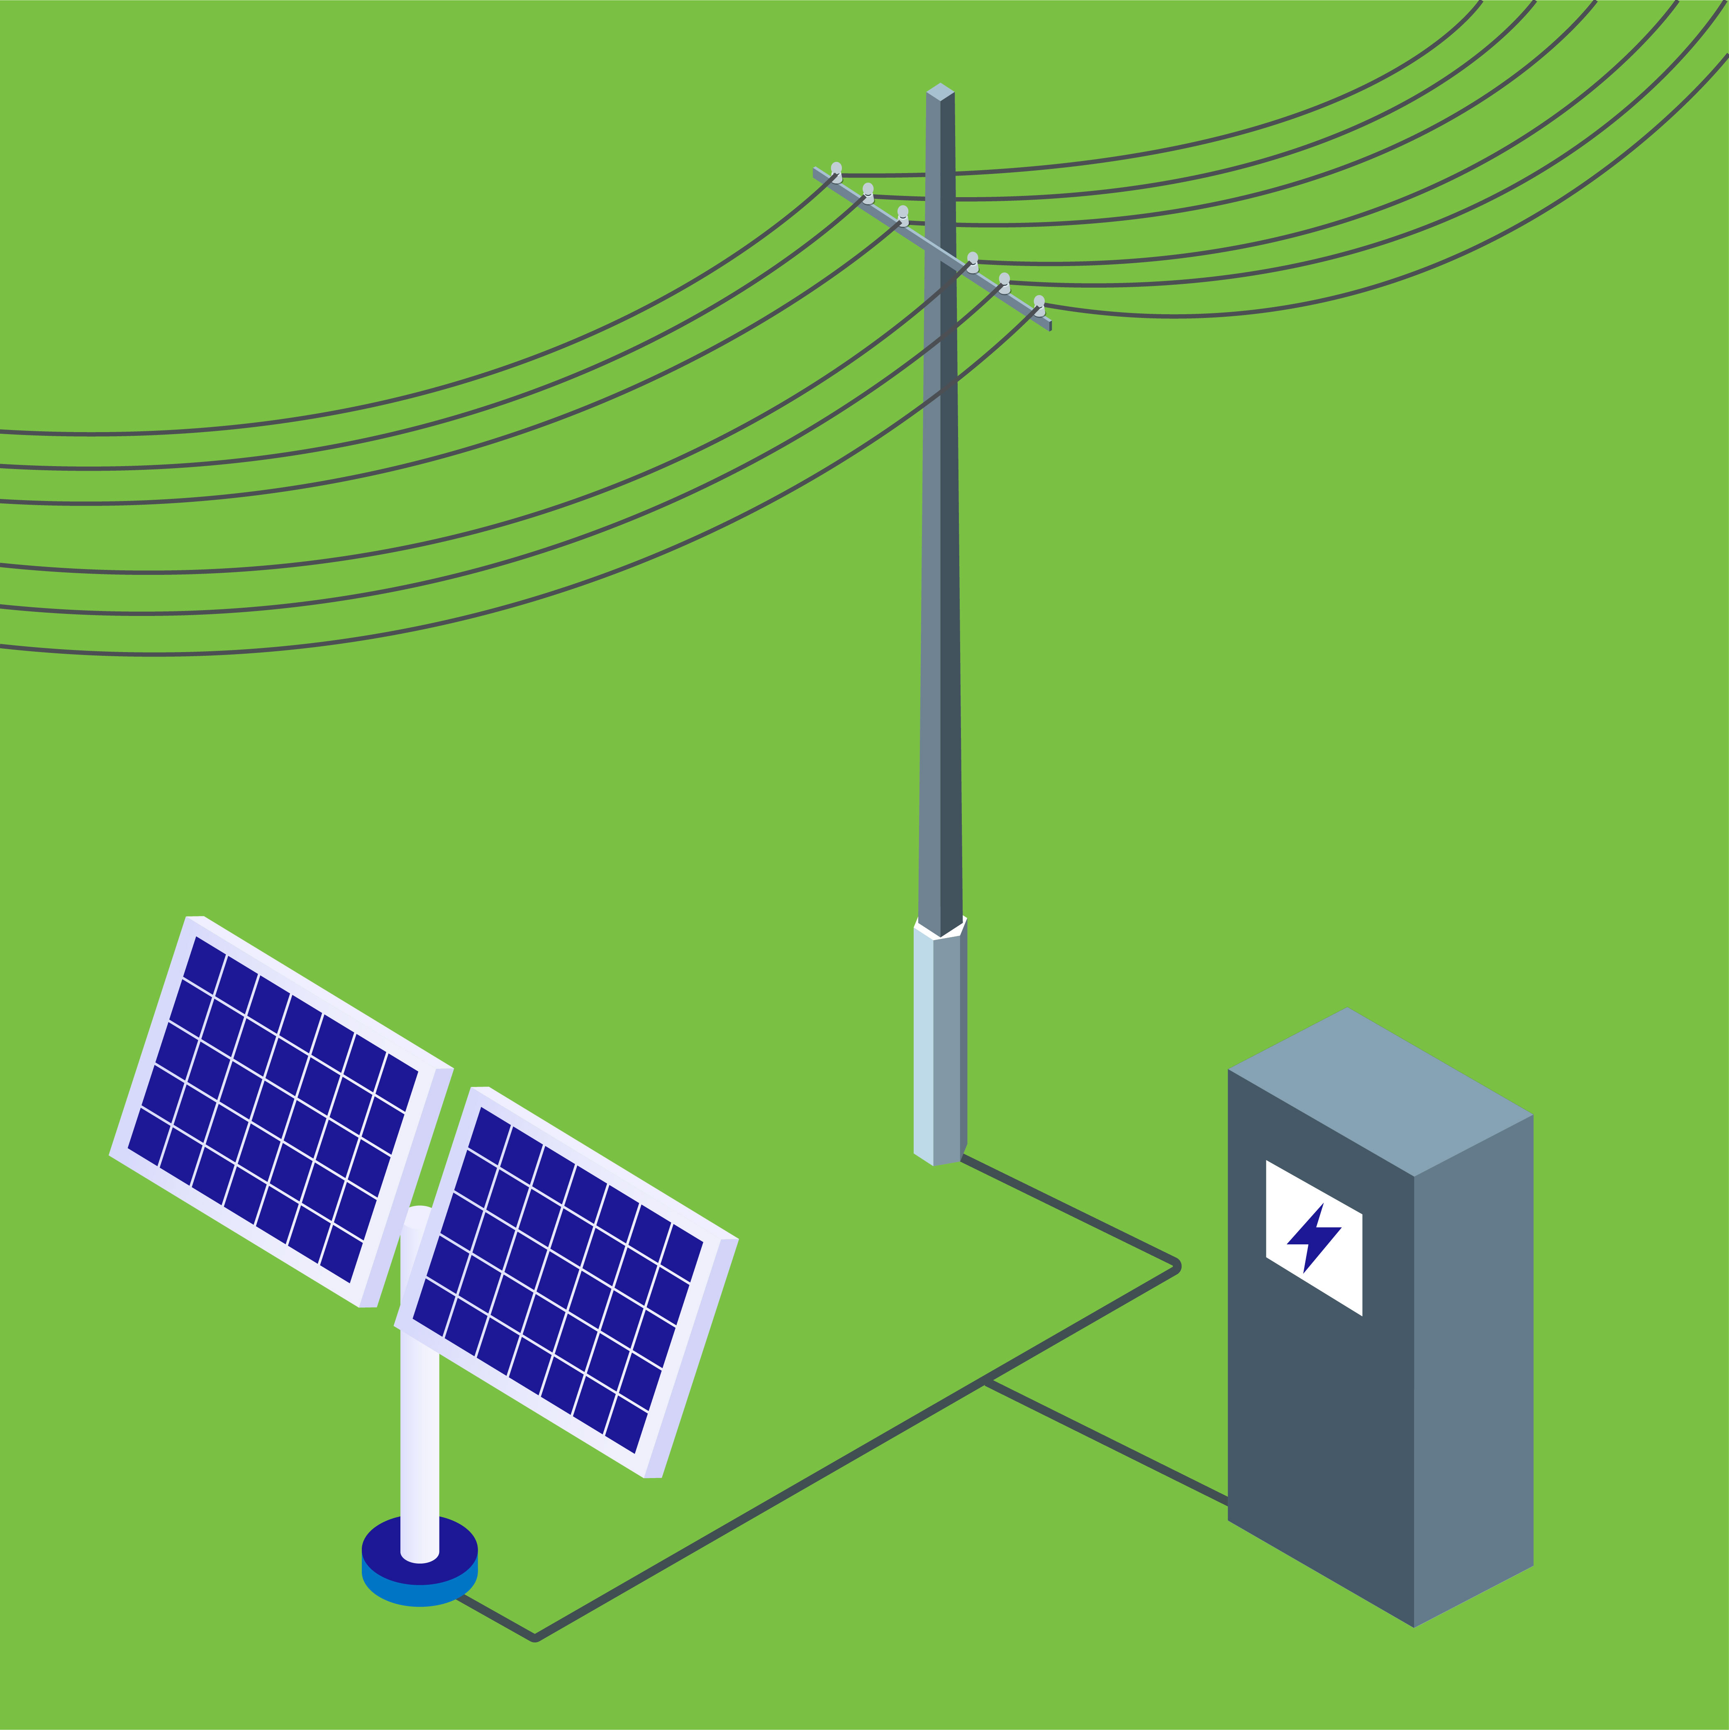
MassCEC Four Focus Areas
High Performance Buildings
Clean Transportation
Net Zero Grid
Offshore Wind
State economic and development agency that seeks to accelerate Massachusetts' clean energy and climate goals

Slide 4
Why Go Electric?
Electrification is the future:
Over 20+ models available from all major manufacturers
Quieter, better for the environment and the health of students & drivers
Cheaper to maintain and fuel than a diesel bus
Why now?
Federal and state funding opportunities
Technology improvement in recent years
Around 5,000 electric school buses in operation across the country

Slide 5
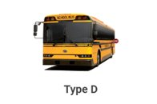
Barriers to Electrification
Upfront Costs:
Electric school buses are 2 to 4 times the cost of a diesel bus ($250 - $400k)
Necessary charging stations + electrical upgrades add significant cost
Project Complexity:
Multiple stakeholders – utility, 3rd party operators, vendors and OEMs
New procurement processes, grant funding requirements
Operational differences (charging vs. fueling)

Slide 6
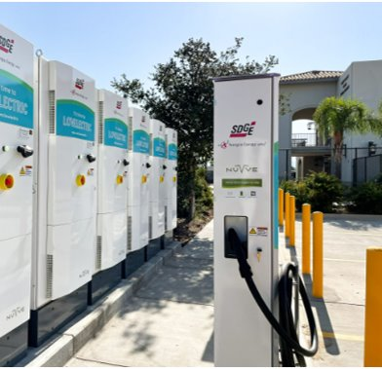
Overcoming Barriers in the Commonwealth
Managing Upfront Costs
Federal and state funding opportunities from EPA and MassCEC - may cover the entire upfront cost of electric school buses and can supplement infrastructure upgrade costs
Turnkey and electrification-as-a-service options available
Breaking Down Project Complexity
Start talking to your utility early and look out for programs like Make-Ready
Technical Assistance from vendors, manufacturers, the World Resources Institute, MassCEC
Turnkey and electrification-as-a-service options available

Slide 7
Commonly asked questions
Range and Cold Weather
Operational Savings
Safety and Driver Experience
Where to Start

Slide 8
Range and Cold Weather
What is the actual operational range of an electric school bus?
"80 miles on a single charge is a safe bet. 100 miles if you do everything perfectly"
Sources: operators (including a 200+ electric school bus fleet in Canada), school districts, manufacturers
Can ESBs operate in cold weather?
Yes! deployments in Canada (80 mile routes), Alaska, Maine, Massachusetts, and Vermont (75 mile routes)
Efficiency does decrease by 20 – 50% due to cabin heating & battery performance but adequate planning and driver behavior can mitigate
Cold start is less of an issue than in diesel buses

Slide 9
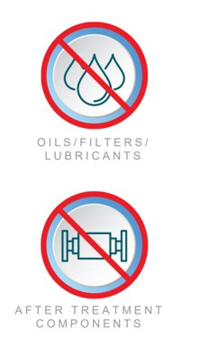
Operational Savings
Do electric school buses actually save money over time?
Yes! MA deployment achieves 60% in maintenance savings and 50% fuel savings with charging management
Largest ESB fleet finds consistent 27% - 30% maintenance savings
How long do batteries last?
8 to 10 years – warranties available from manufacturers

Slide 10
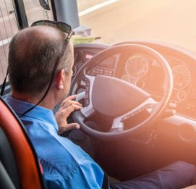
Safety and Driver Experience
What is the training like for drivers of electric school buses?​
Straightforward and similar to driving diesel buses​
Manufacturers often offer training​
Consistent positive feedback from drivers - smoother and quieter drive​
Are there different safety concerns? ​
Safer for public health​
Potential for integrated sensors and controls for increased driving safety​
Batteries go through rigorous testing for fire safety

Slide 11
Where to Start: Guides and Resources
World Resources Institute (WRI)
Electric School Bus Market Buyer's Guide
Electric School Bus Sample Pitch Deck
Request for Information (RFI) Template
Electric School Bus Power Planner
U.S. Department of Energy
Alternative Fuels Data Center
A collection of materials to help you plan for
electric school bus deployment

Slide 12
Funding opportunities
Federal and State

Slide 13
EPA Clean School Bus Program
$5 billion over five years (FY22-FY26)
Focus on ‘prioritized areas’
FY22 Rebates (closed)
$4 billion in applications
>12,000 buses; >90% electric
$965 million awarded
FY23 grant funding
~Open spring 2023
Targeted for larger bus fleets
Smaller fleets targeted for FY23 rebates

Slide 14
EPA Clean School Bus Rebate Program – Region 1
School District State | School District Name | School District City | # Buses Requested | Total Funds Requested
CT | Cornwall School District | Cornwall | 1 | $ 395,000.00
CT | Regional School District 01 | Falls Village | 1 | $ 395,000.00
CT | Sharon School District | Sharon | 1 | $ 395,000.00
CT | Connecticut Technical Education and Career System | Hartford | 25 | $ 7,625,000.00
MA | New Bedford | New Bedford | 14 | $ 5,530,000.00
MA | Lawrence | Lawrence | 25 | $ 9,875,000.00
MA | Fall River | Fall River | 11 | $ 3,895,000.00
MA | Upper Cape Cod Regional Vocational Technical | Bourne | 1 | $ 395,000.00
MA | Lower Pioneer Valley Educational Collaborative | West Springfield | 25 | $ 9,875,000.00
ME | Mt Desert CSD | Bar Harbor | 1 | $ 395,000.00
ME | Southwest Harbor Public Schools | Bar Harbor | 1 | $ 395,000.00
ME | Winthrop Public Schools | Winthrop | 4 | $ 1,580,000.00
ME | Pleasant Point | Calais | 3 | $ 1,095,000.00
ME | RSU 20 | Searsport | 2 | $ 790,000.00
ME | RSU 57/MSAD 57 | Waterboro | 2 | $ 790,000.00
ME | RSU 12 | Somerville | 2 | $ 790,000.00
ME | Dayton Public Schools | Dayton | 4 | $ 1,580,000.00
ME | Castine Public Schools | Blue Hill | 1 | $ 395,000.00
ME | Waite Public Schools | Baileyville | 1 | $ 395,000.00
ME | RSU 83/MSAD 13 | Bingham | 1 | $ 395,000.00
ME | East Range CSD | Baileyville | 1 | $ 395,000.00
ME | Wells-Ogunquit CSD | Wells | 11 | $ 4,345,000.00
NH | Rumney School District | Plymouth | 3 | $ 1,185,000.00
NH | Henniker SAU Office | Henniker | 4 | $ 1,580,000.00
RI | Blackstone Valley Prep A RI Mayoral Academy | Cumberland | 24 | $ 9,480,000.00
RI | Woonsocket | Woonsocket | 1 | $ 395,000.00
VT | Caledonia Central Supervisory Union | Danville | 1 | $ 395,000.00
VT | White River Valley Supervisory Union | Royalton | 3 | $ 1,185,000.00
VT | Windsor Central Supervisory Union | Woodstock | 3 | $ 1,185,000.00
VT | Taconic and Green Regional School District | Sunderland | 4 | $ 1,580,000.00
Total |  |  | 181 | $ 68,705,000.00
Overwhelming response to FY22 rebate solicitation
30 school districts
180+ electric buses
>$68 million
Waitlist for those not initially selected in lottery
Future rounds to follow
https://www.epa.gov/system/files/documents/2022-10/List-of-CSB-Rebate-FY2022-Selectees-Final.pdf

Slide 15
EPA Clean School Bus Program – Next Steps for Recipients

Slide 16
EPA Clean School Bus Program Resources & Next Steps
Clean School Bus Website
https://www.epa.gov/cleanschoolbus
Stay up-to-date!
Sign-up for the listserv
Contact your utility!
Applicants must have active SAM.gov accounts!
Technical Assistance
Joint Office of Energy and Transportation and the National Renewable Laboratory

Slide 17
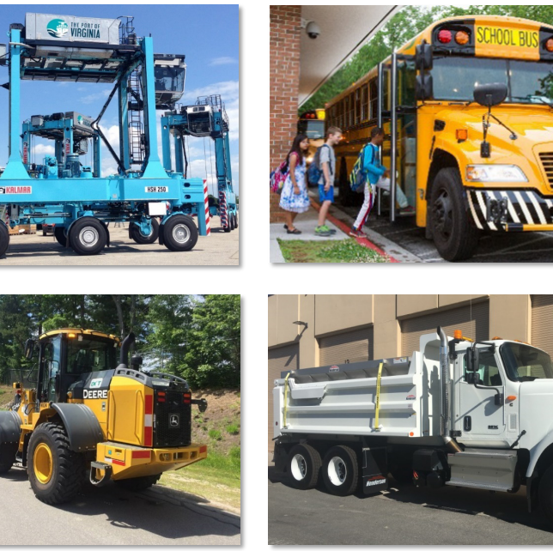
EPA’s Diesel Emission Reduction Act (DERA) Funding Program
Authorizes EPA $100 million annually thru 2024
DERA Competitive Funding (70%)
Annual RFA (Anticipated late 2022;
~$3.4 million available for R1
2-year phased projects
DERA State Funding (30%)
Tribal Program RFA (Closed Oct)

Slide 18
EPA Clean School Bus Program Resources
Clean School Bus Website
https://www.epa.gov/cleanschoolbus
Stay up-to-date!
Sign up for the listserv
Technical Assistance
Joint Office of Energy and Transportation and the National Renewable Laboratory

Slide 19
State Funding Opportunities
ACT School Bus (Massachusetts Clean Energy Center – MassCEC)
Grant and technical assistance
Goal to accelerate ESB adoption in Massachusetts and amplify EPA's Clean School Bus Program
MOR-EV Trucks (Department of Energy Resources – DOER)
Rebate Program
Goal to reduce air pollution emissions in Massachusetts by increasing the use of medium duty and heavy duty on-road electric vehicles, including trucks, buses and vans.

Slide 20
ACT School Bus Offers...
1. Deployment Assistance – Up to $2M in flexible funding available for 3 school bus fleets. Technical assistant to guide the EV bus deployment process
ESB charging station planning, infrastructure deployment, and data collection
CLOSED
2. Advisory Services – Free electrification planning for up to 25 school bus fleets. Includes preparing districts to access additional funding opportunities
Feasibility designs, financial models, procurement plans
ONGOING ENROLLMENT THROUGH FALL 2022

Slide 21
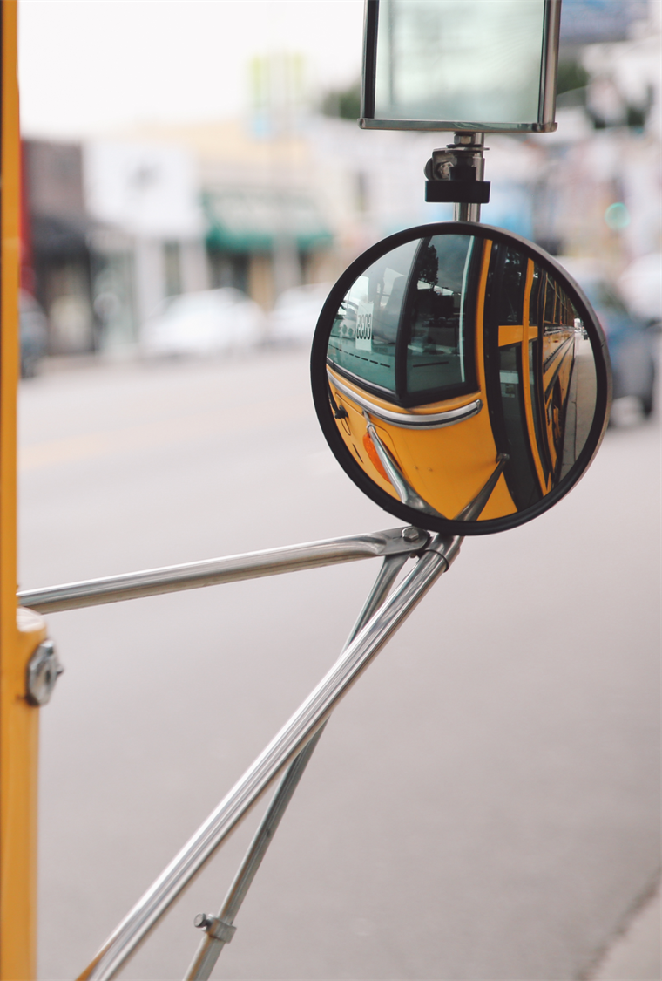
ACT School Bus Advisory Services
Looking for an actionable plan to electrify your fleet?
Advisory Services can help answer questions like:
What other funding opportunities are out there?
Which routes are best fit for early electrification?
What are key areas for costs and savings?
What are the best charging options for your fleet?
What infrastructure changes should be made to your bus depot?
Fill out our Interest Form to receive more information about Advisory Services!
Notes:
End message: consultants for road mapping and deployment that will walk you through funding opportunities – what the consultant can do for the fleets. ABout the consultants

Slide 22
CATALYST
Advisory Services - Eligibility and Prioritization
School districts OR 3rd party school bus fleets (in partnership with school districts) may directly apply to receive free electrification advisory services
EPA Priority Districts and 3rd party school bus fleets partnered with Priority Districts will be given preference in enrollment
Goal of geographic and ownership model diversity
Each of the 25 school district fleets will receive a customized fleet electrification plan and hands-on assistance from a team of experts

Slide 23
MassCEC Is Here to Support You!
Please submit questions to: CleanTransportation@masscec.com
ACT School Bus Opportunity:
ACT School Bus Landing Page
ACT School Bus Advisory Services Interest Form
Contact us directly: jlu@masscec.com and ostrobel@masscec.com
Sign up for our office hours
Don't hesitate to reach out!

